Slide 1

What's new in telemetry

Slide 2
Agenda
Insights: Analyzing performance
Insights: Analyzing errors
Coming soon (23.0 and later)
Tips and tricks
Resources

Slide 3
Analyzing performance

Slide 4
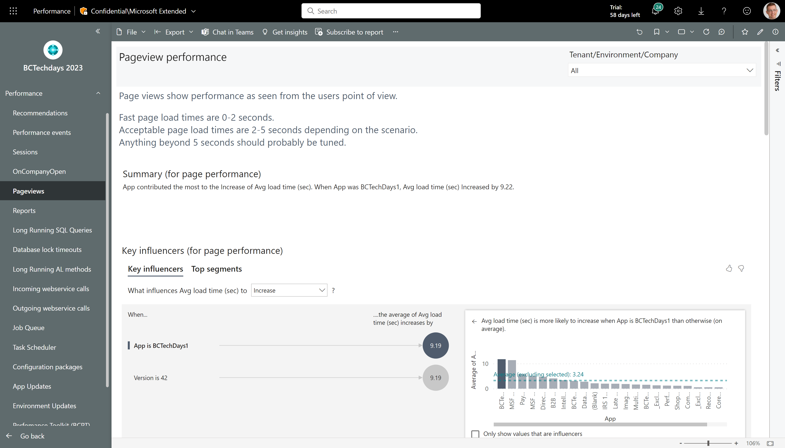
AI assisted performance analysis
Most pages in the performance report has these overview visuals:
An AI generated summary in English
AI generated key influencers to performance metrics
AI generated segmentation of the dataset for this page
An AI guided decomposition tree where you can analyze patterns
Top 10 slowest entities
Top 10 slowest entities over time

Slide 5
AI assisted performance analysis - summary
AI generated summary in English (might not show anything if there is not enough data for the AI to analyze.)

Slide 6
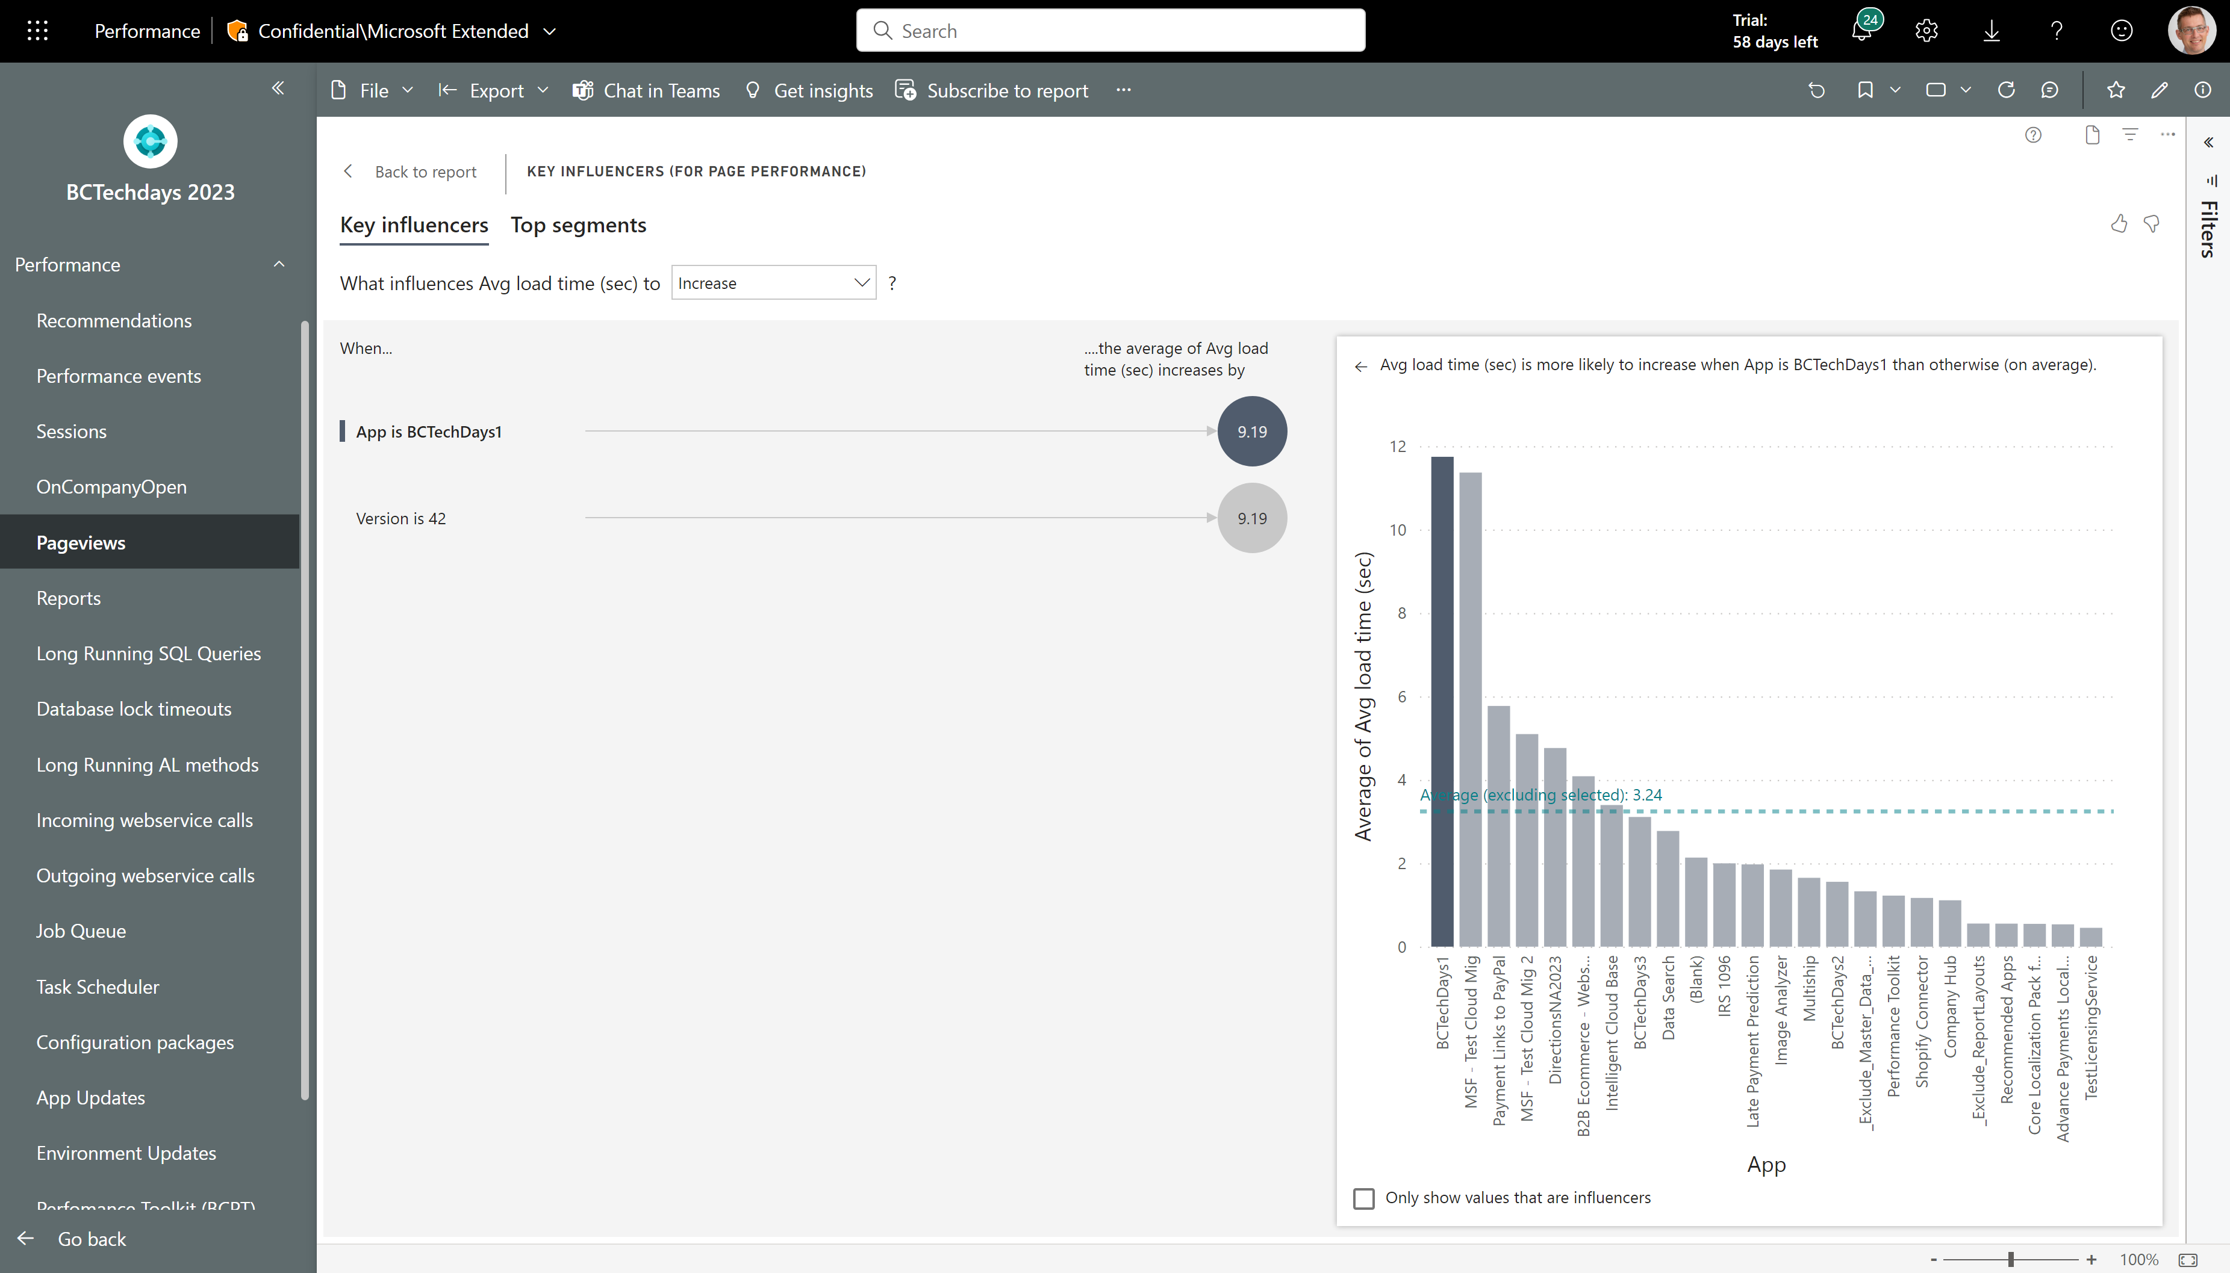
AI assisted performance analysis - key influencers
AI generated key influencers to performance metrics (might not show anything if there is not enough data for the AI to analyze.) Click on an insight to compare to the average of the full population.

Slide 7
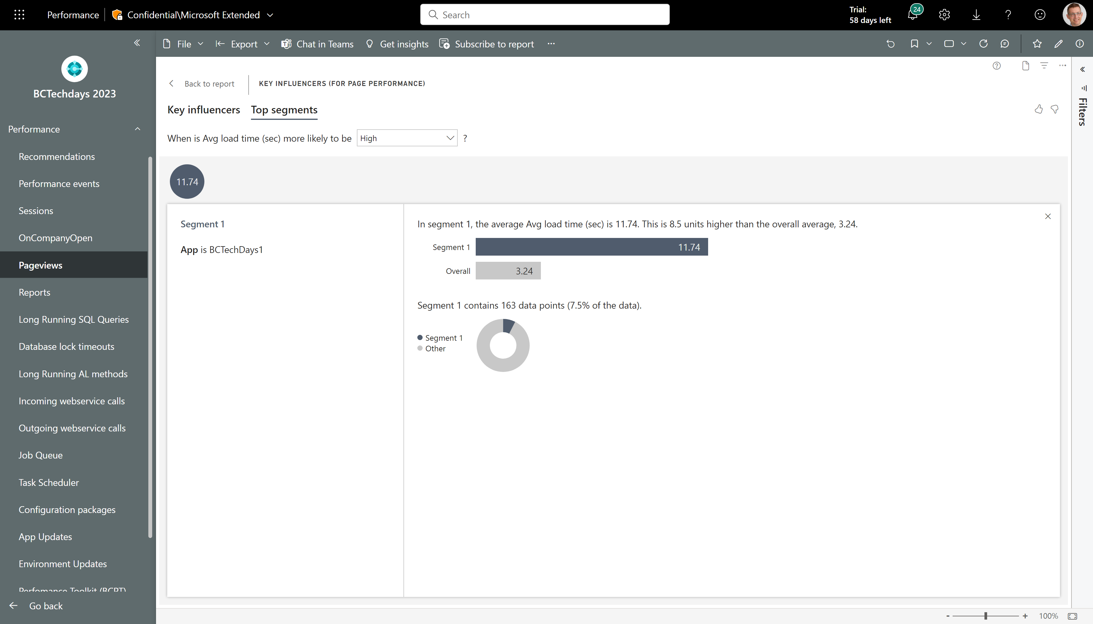
AI assisted performance analysis – Top segments
AI generated segmentation of the dataset for this page (might not show anything if there is not enough data for the AI to analyze.) Click on a segment to learn more

Slide 8
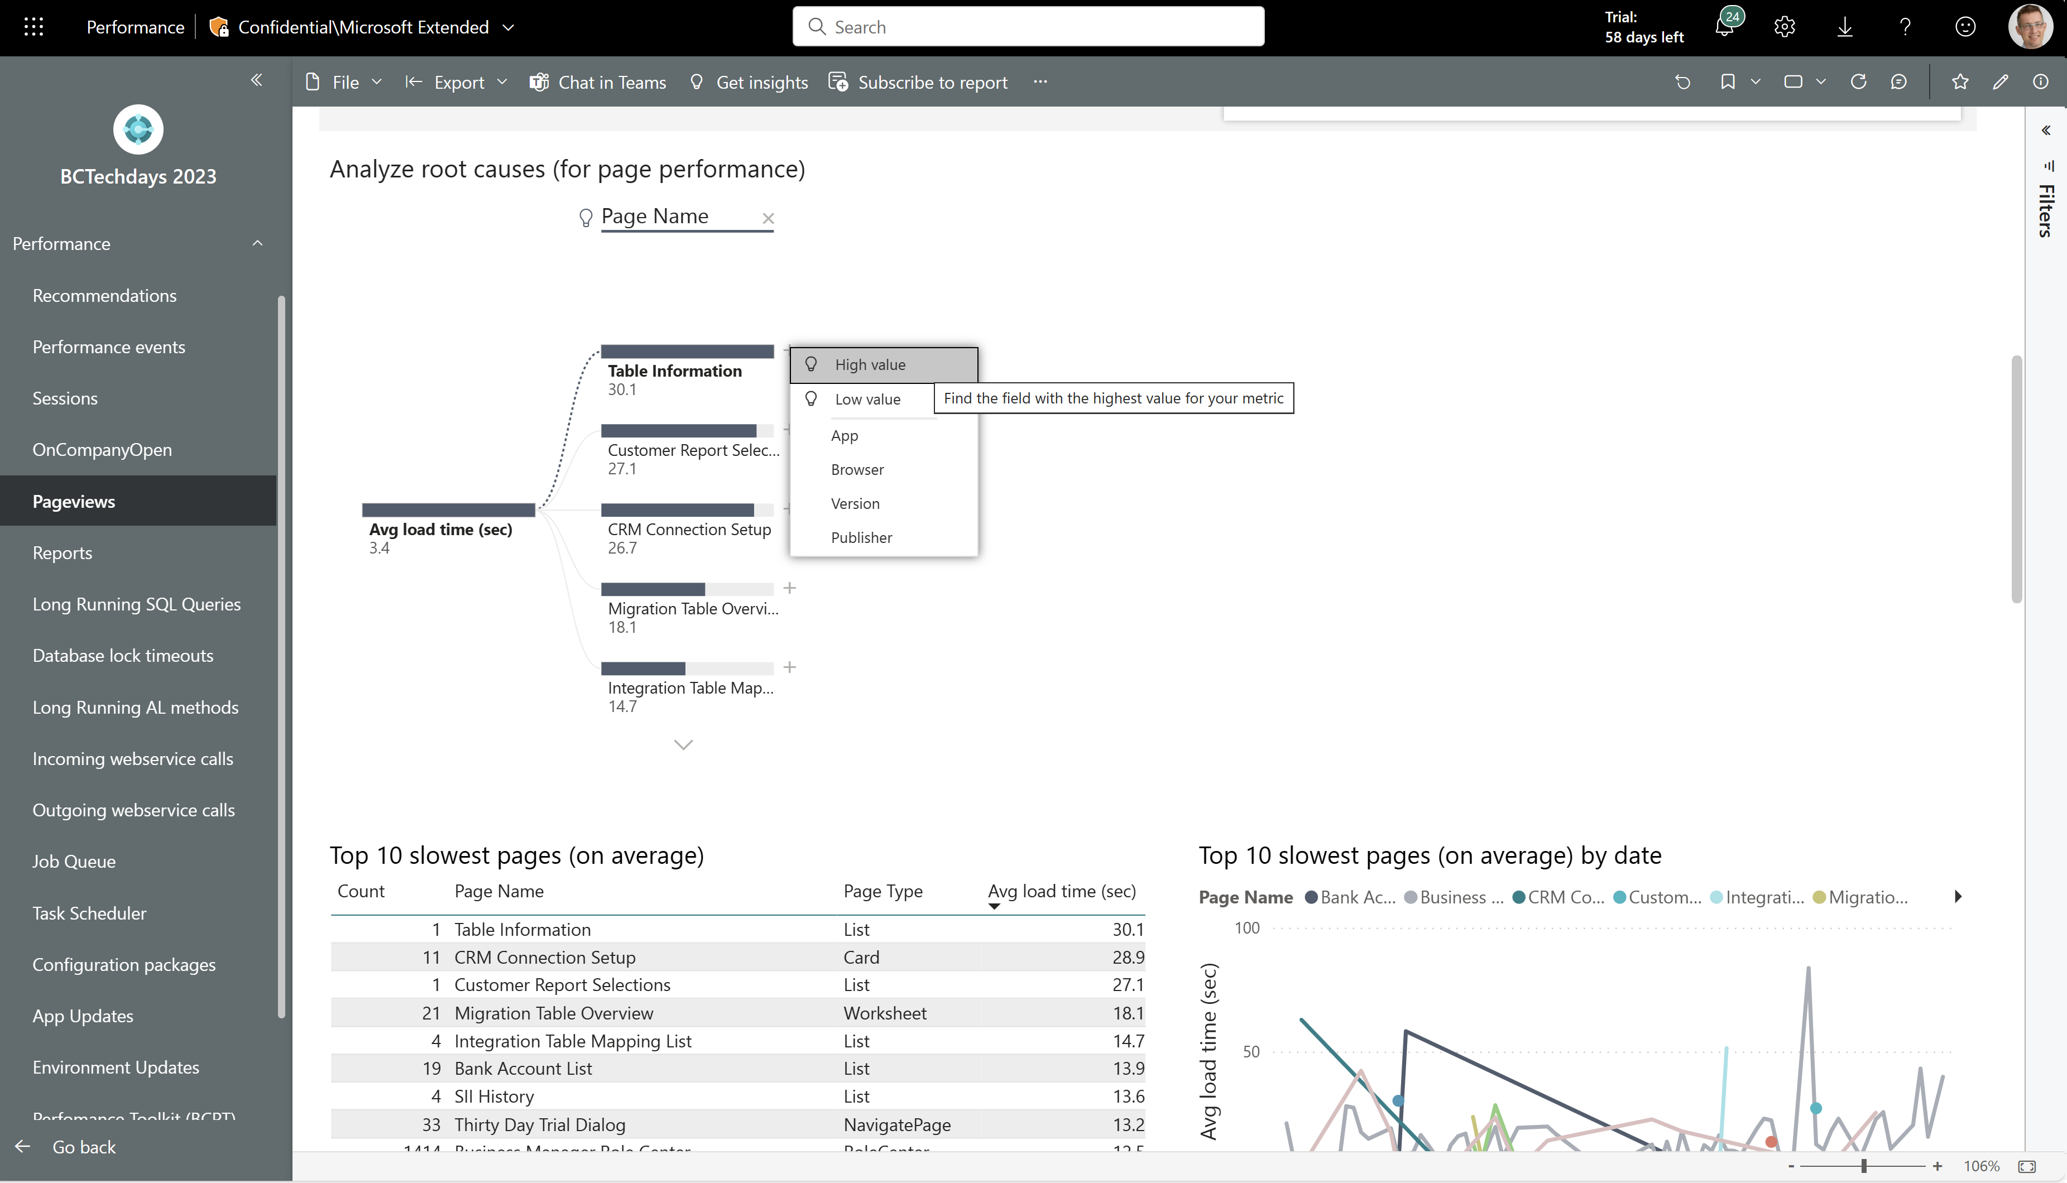
AI assisted performance analysis – Analyze root causes
An AI guided decomposition tree where you can analyze patterns.
Let AI pick the next step (see the light bulp icons) or pick the dimension you want to explore.

Slide 9
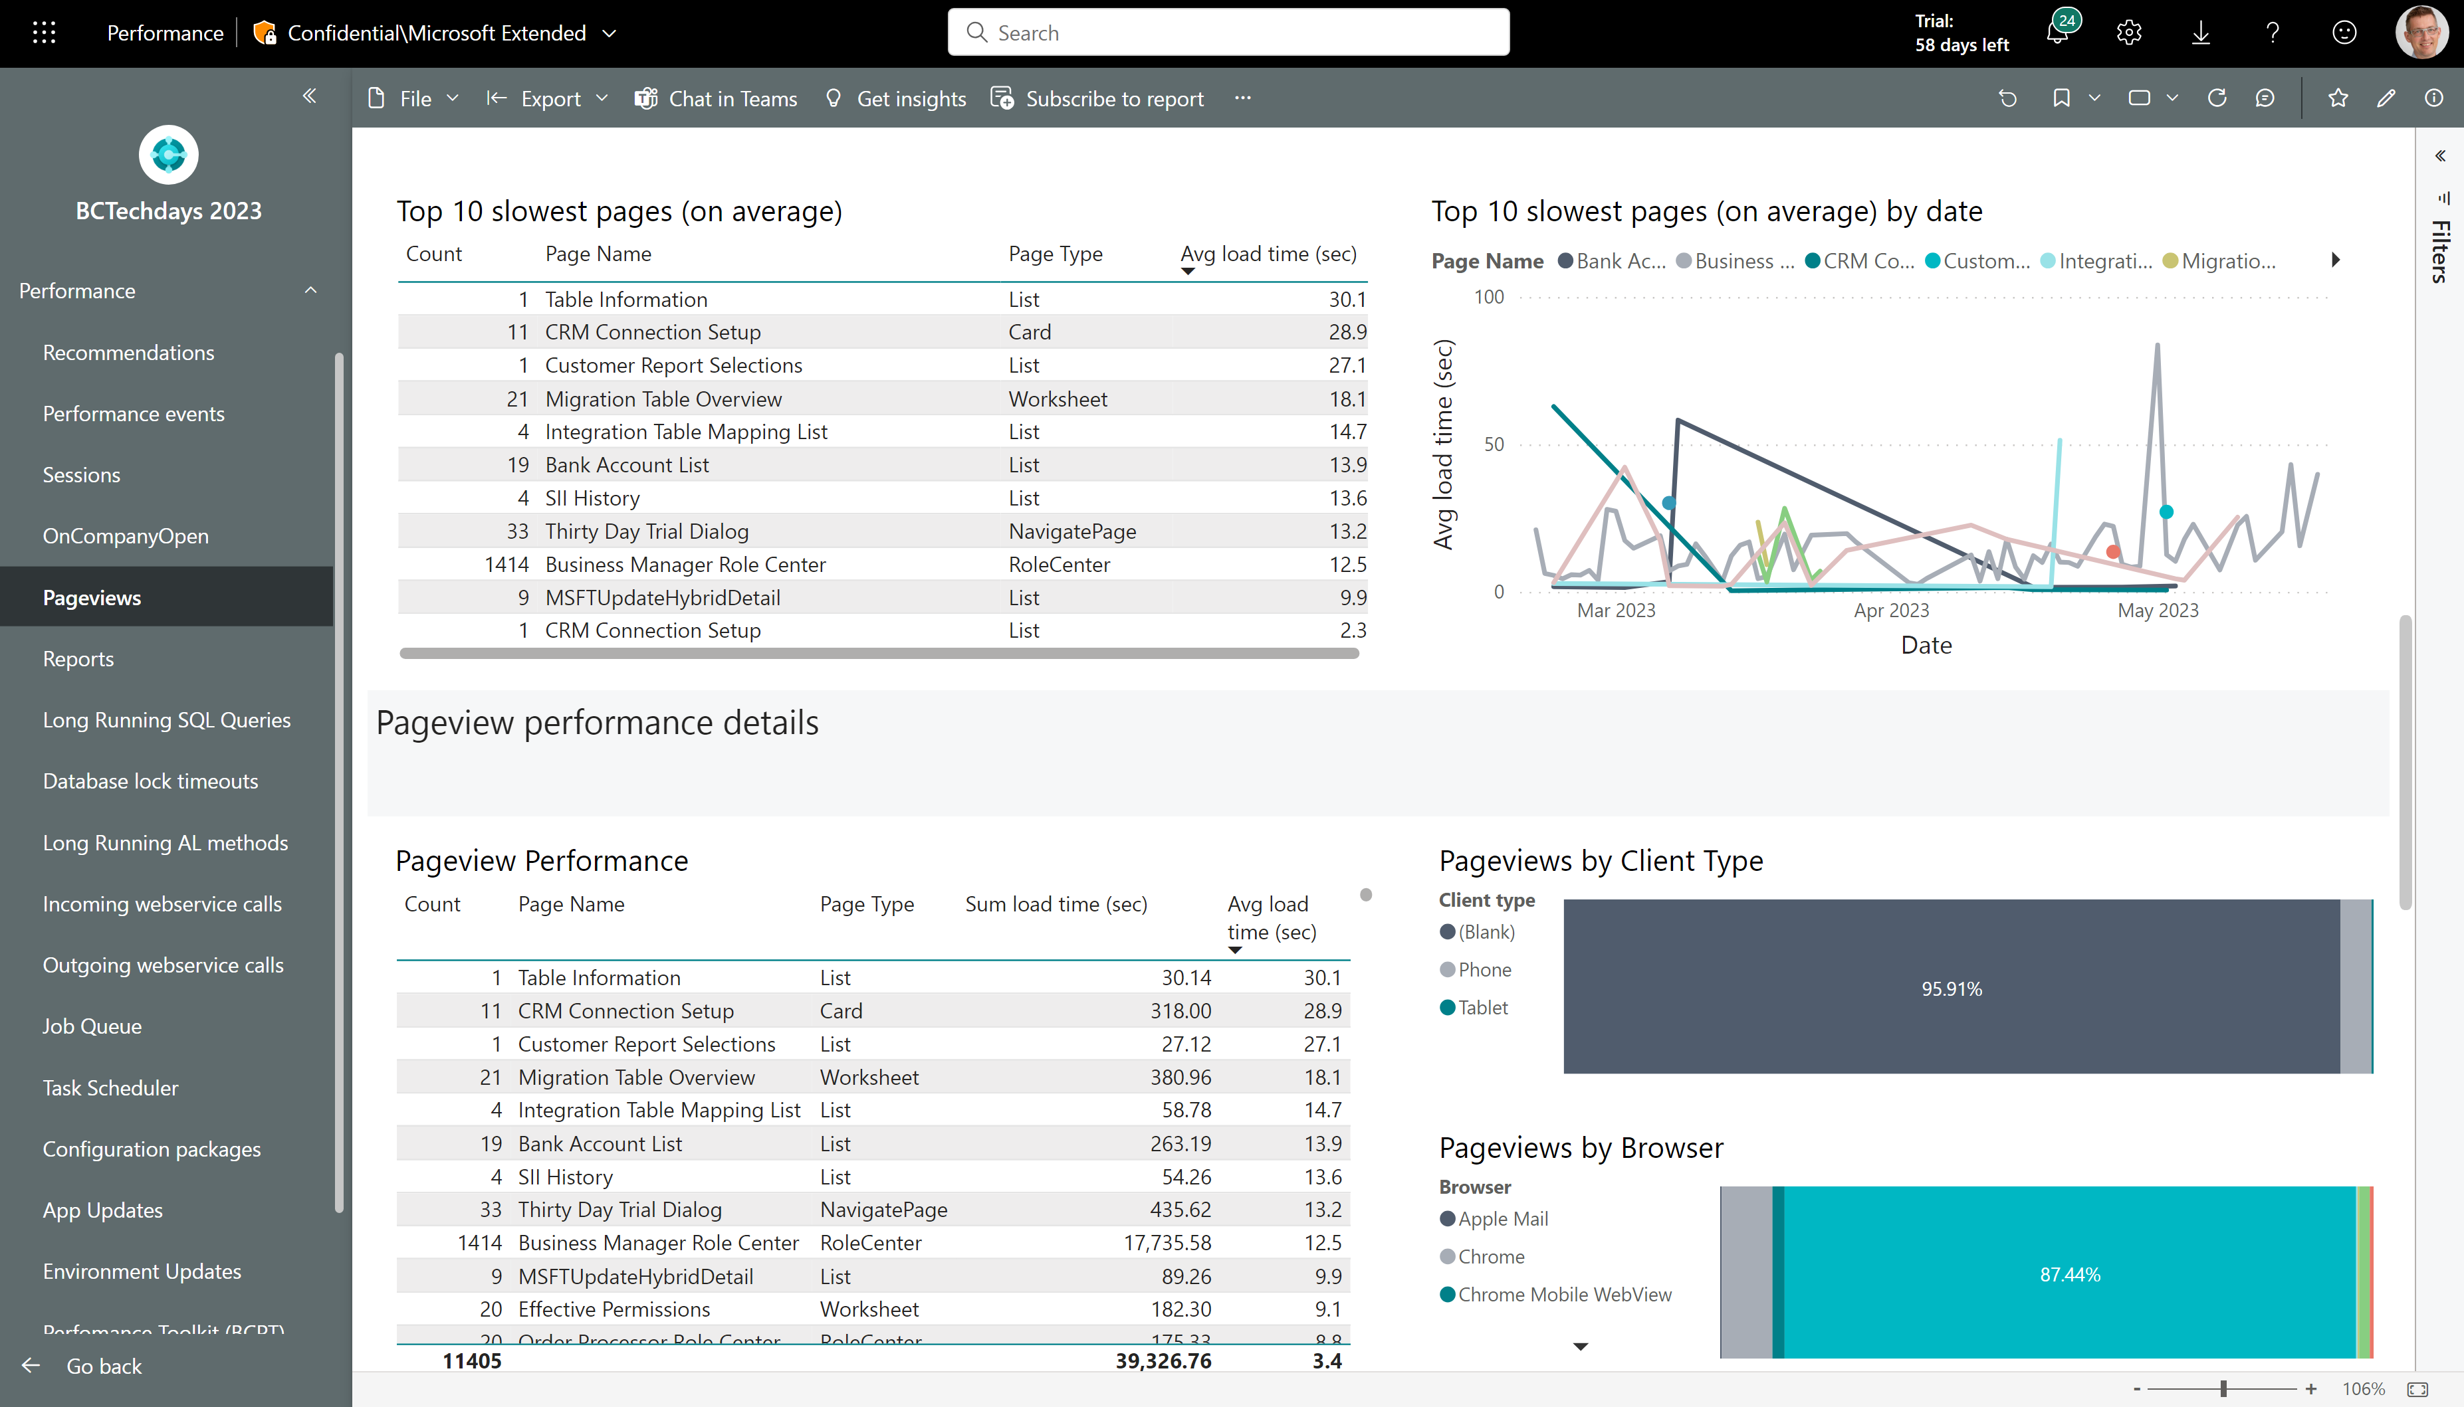
AI assisted performance analysis – Top 10 slowest
See top 10 slowest entities (on average) and top 10 slowest entities over time
Pick one row and then scroll down to the detail report (which is now filtered to your choice)

Slide 10
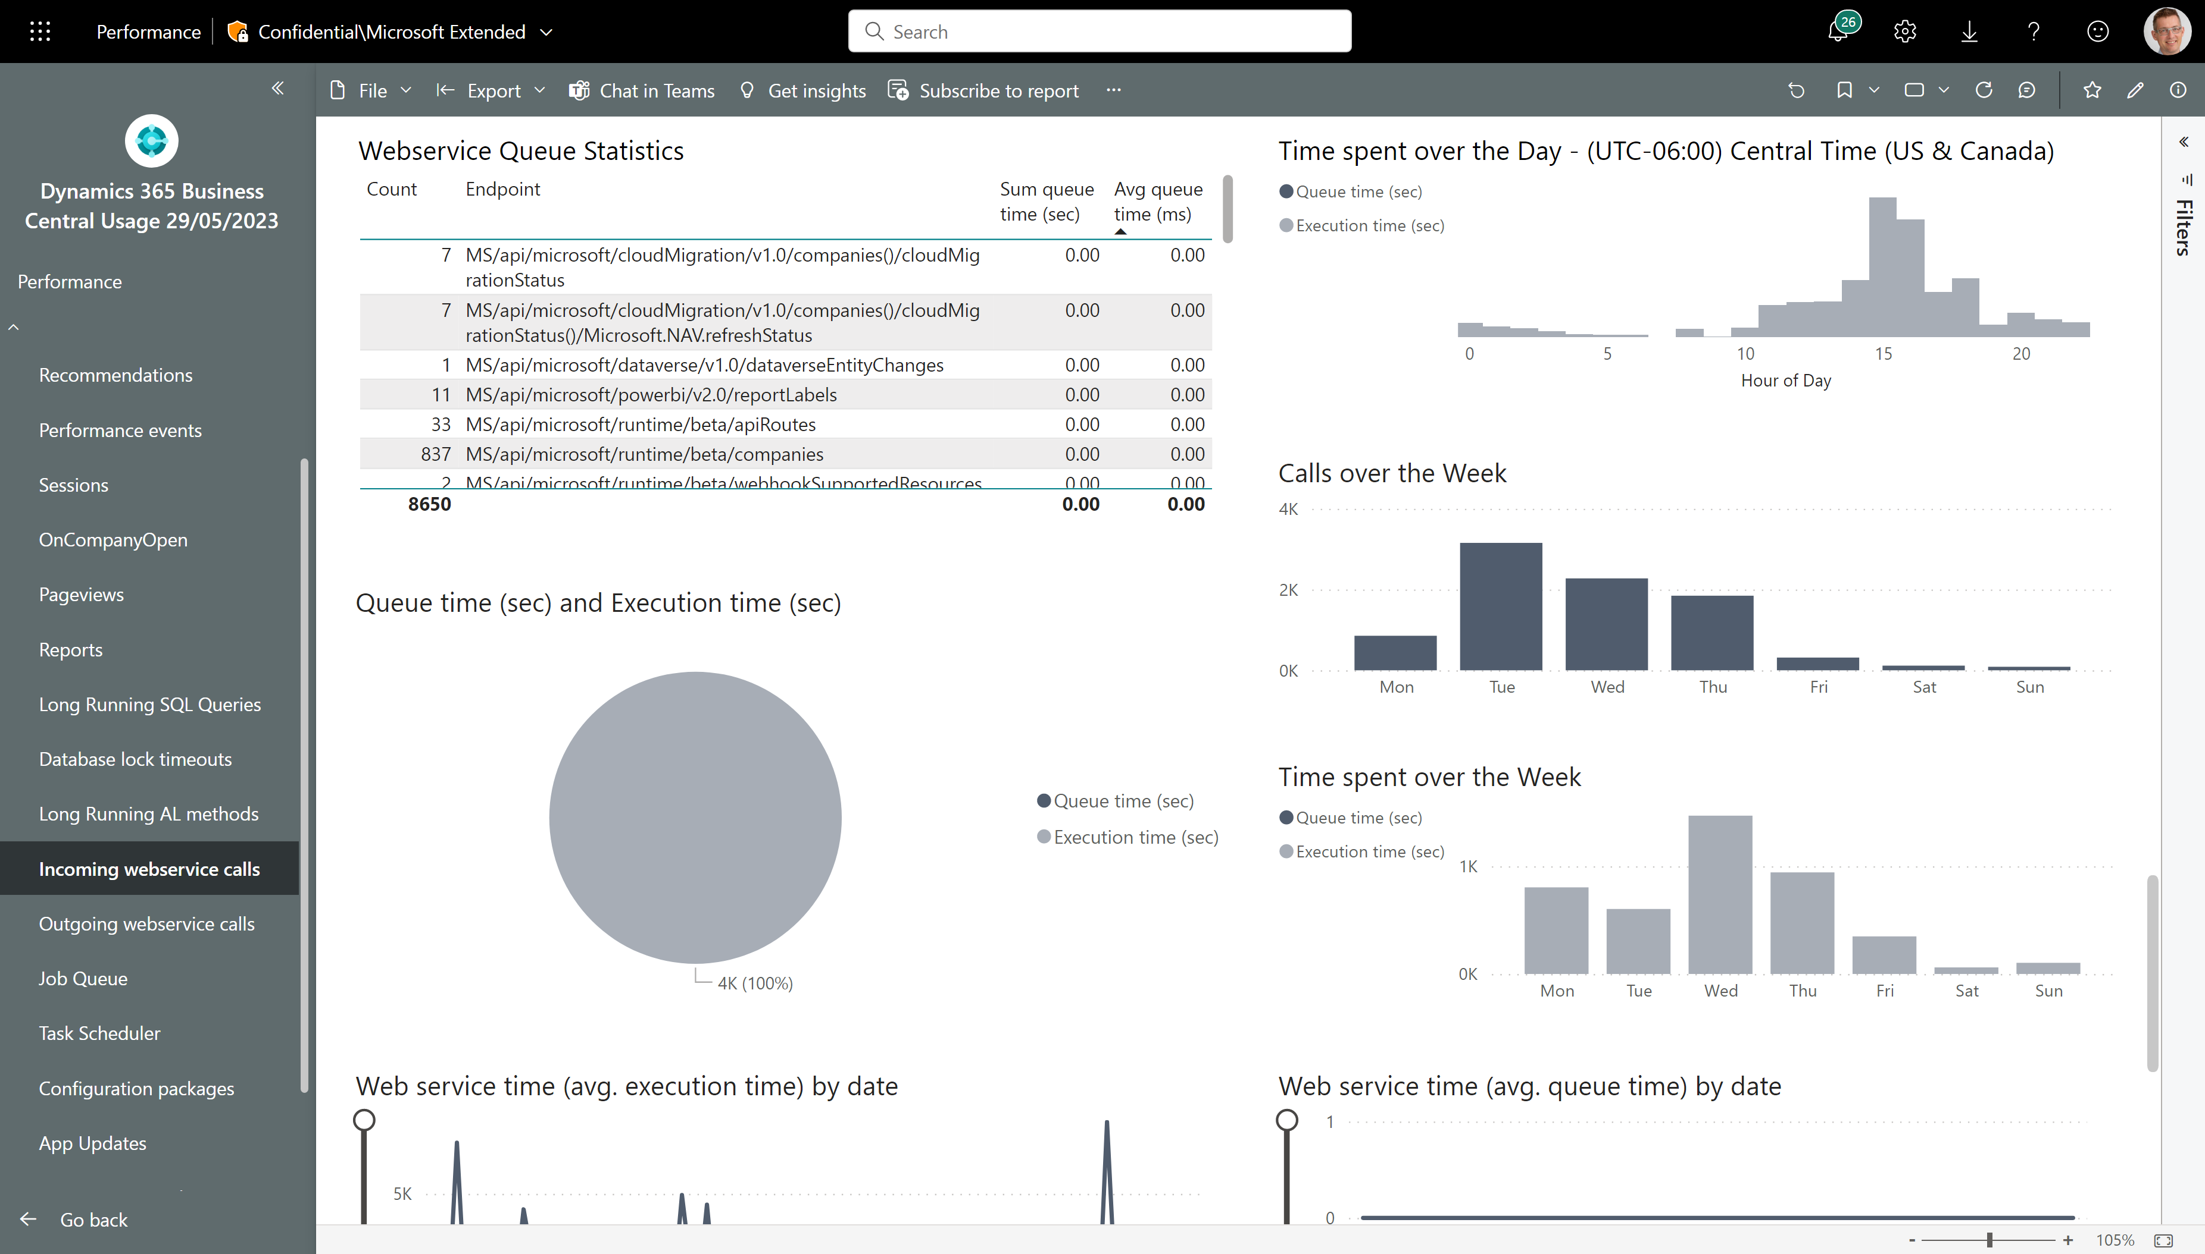
Does your API calls get queued up?
Queue time statistics, anyone?

Slide 11
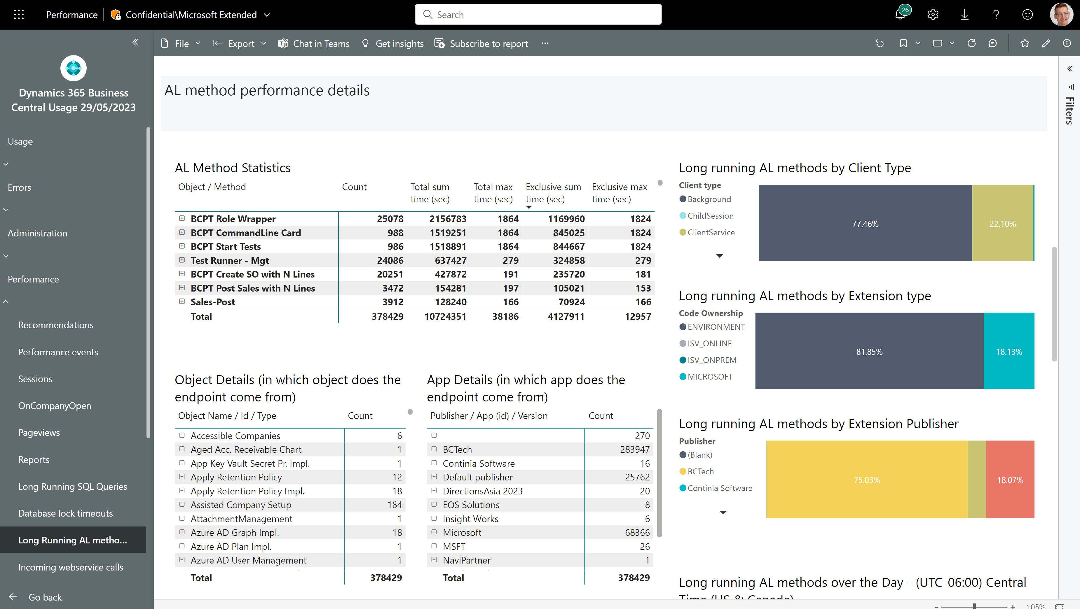
Long running AL methods – total and exclusive time
Now shows both total time and exclusive time

Slide 12
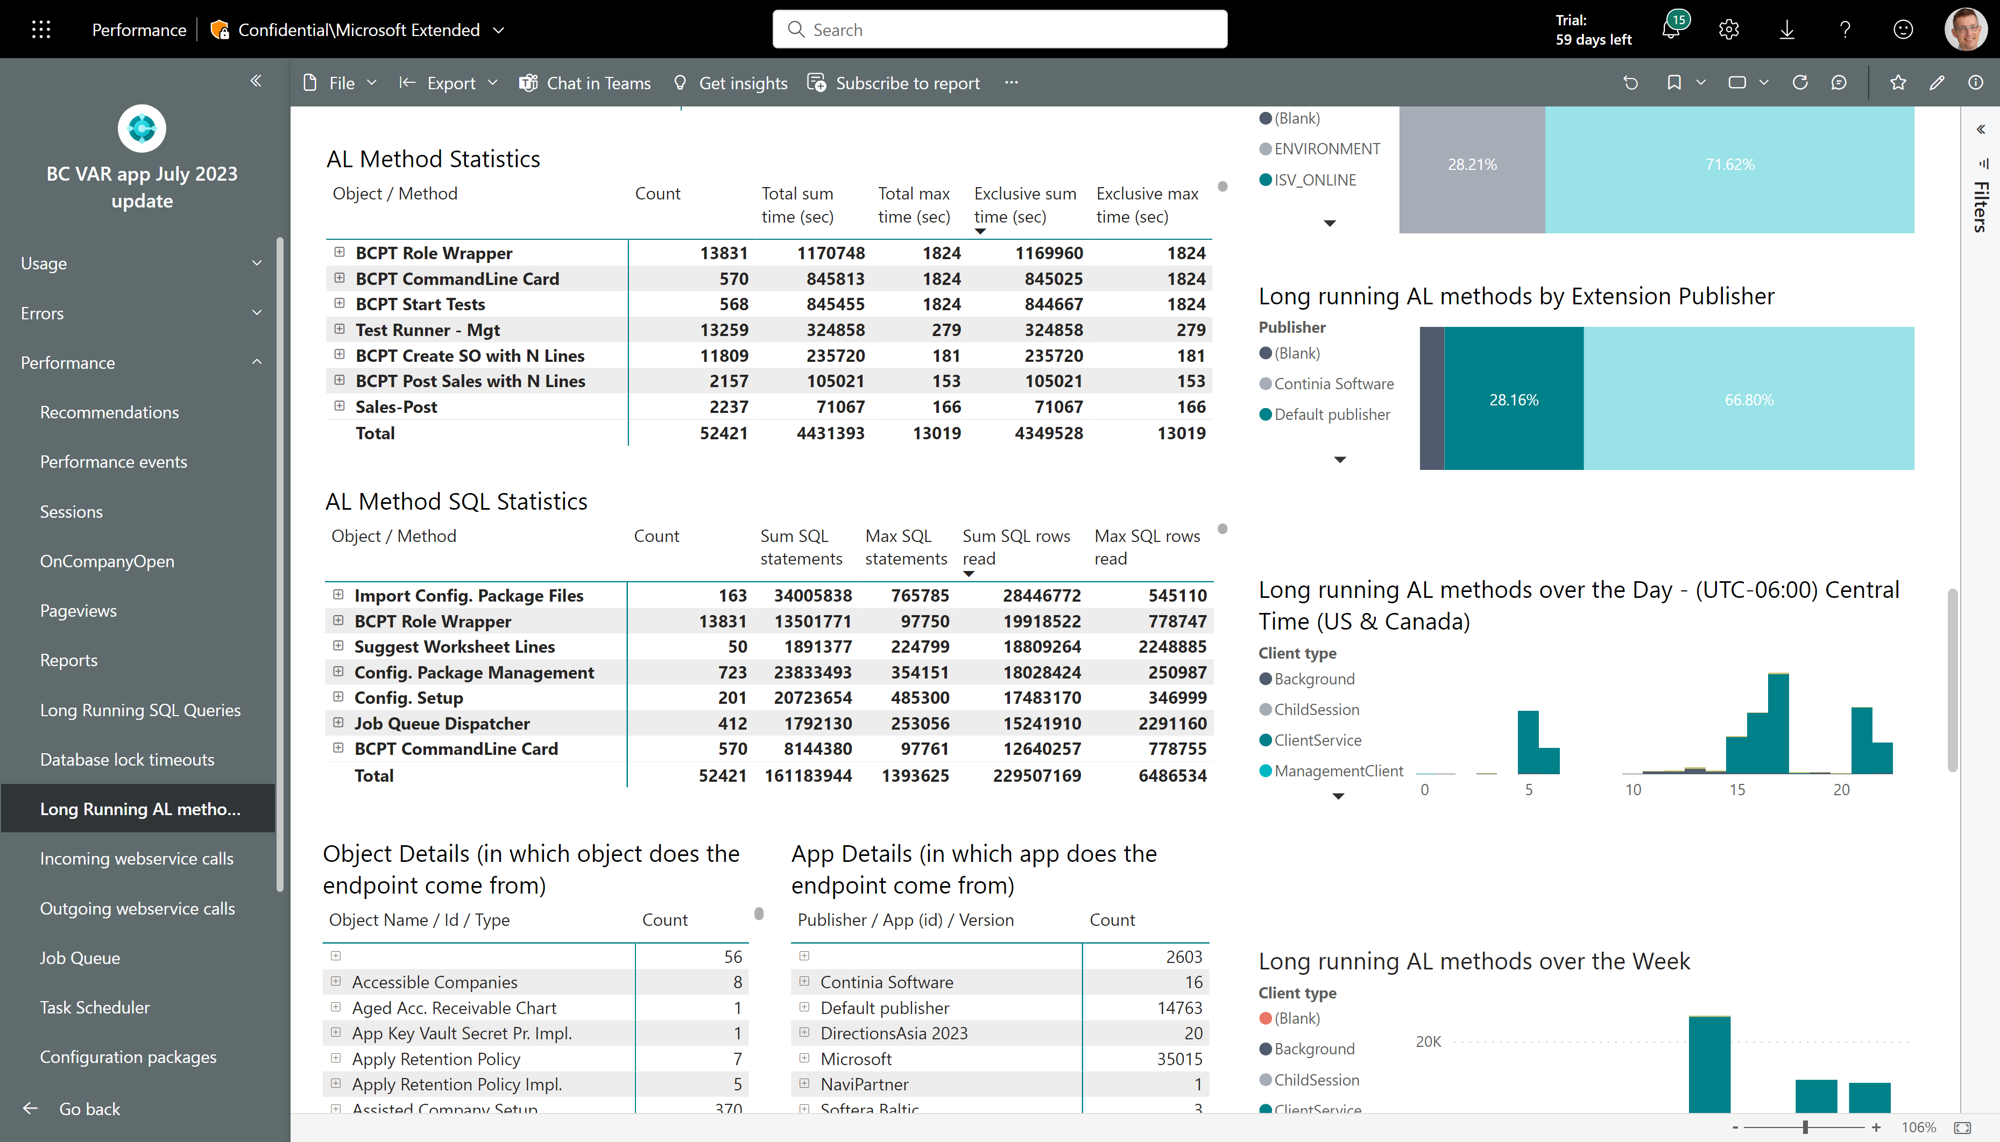
Long running AL methods – see SQL statistics
Now also shows SQL statistics for long running AL methods
SQL statistics can help you determine if a long running AL method is not only spending a lot of time running AL, but as well is also doing work on the database.
Note that the time captured in this event does not include time spend in SQL.

Slide 13
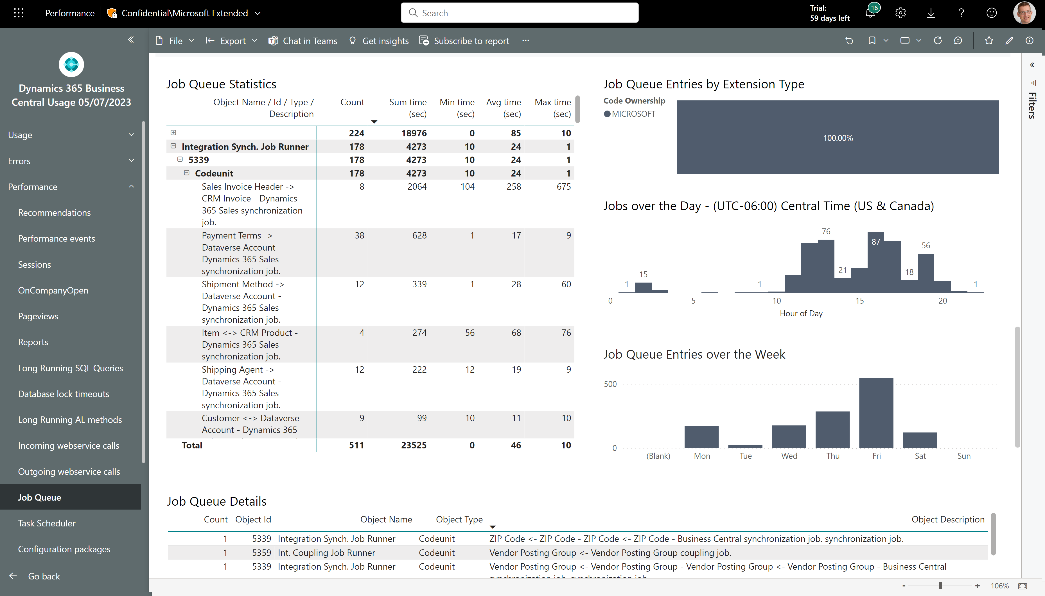
Job Queue Performance – see Job Queue description
Job Queue Descriptions are now emitted to telemetry

Slide 14
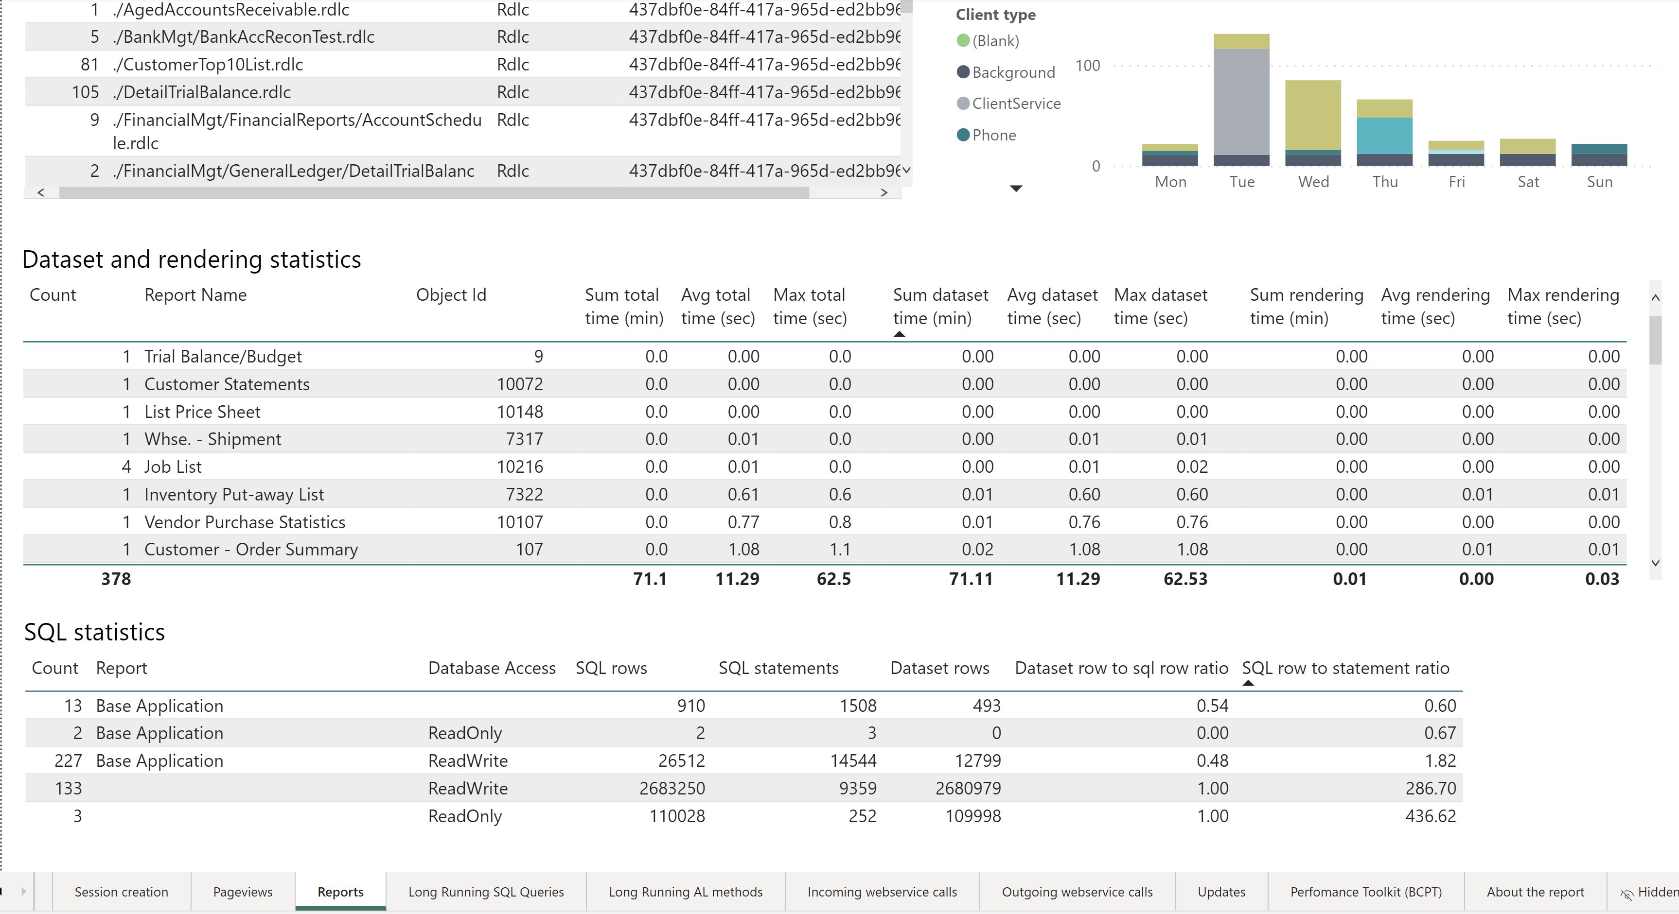
Report performance – showing rendering statistics

Slide 15
Analyzing errors

Slide 16
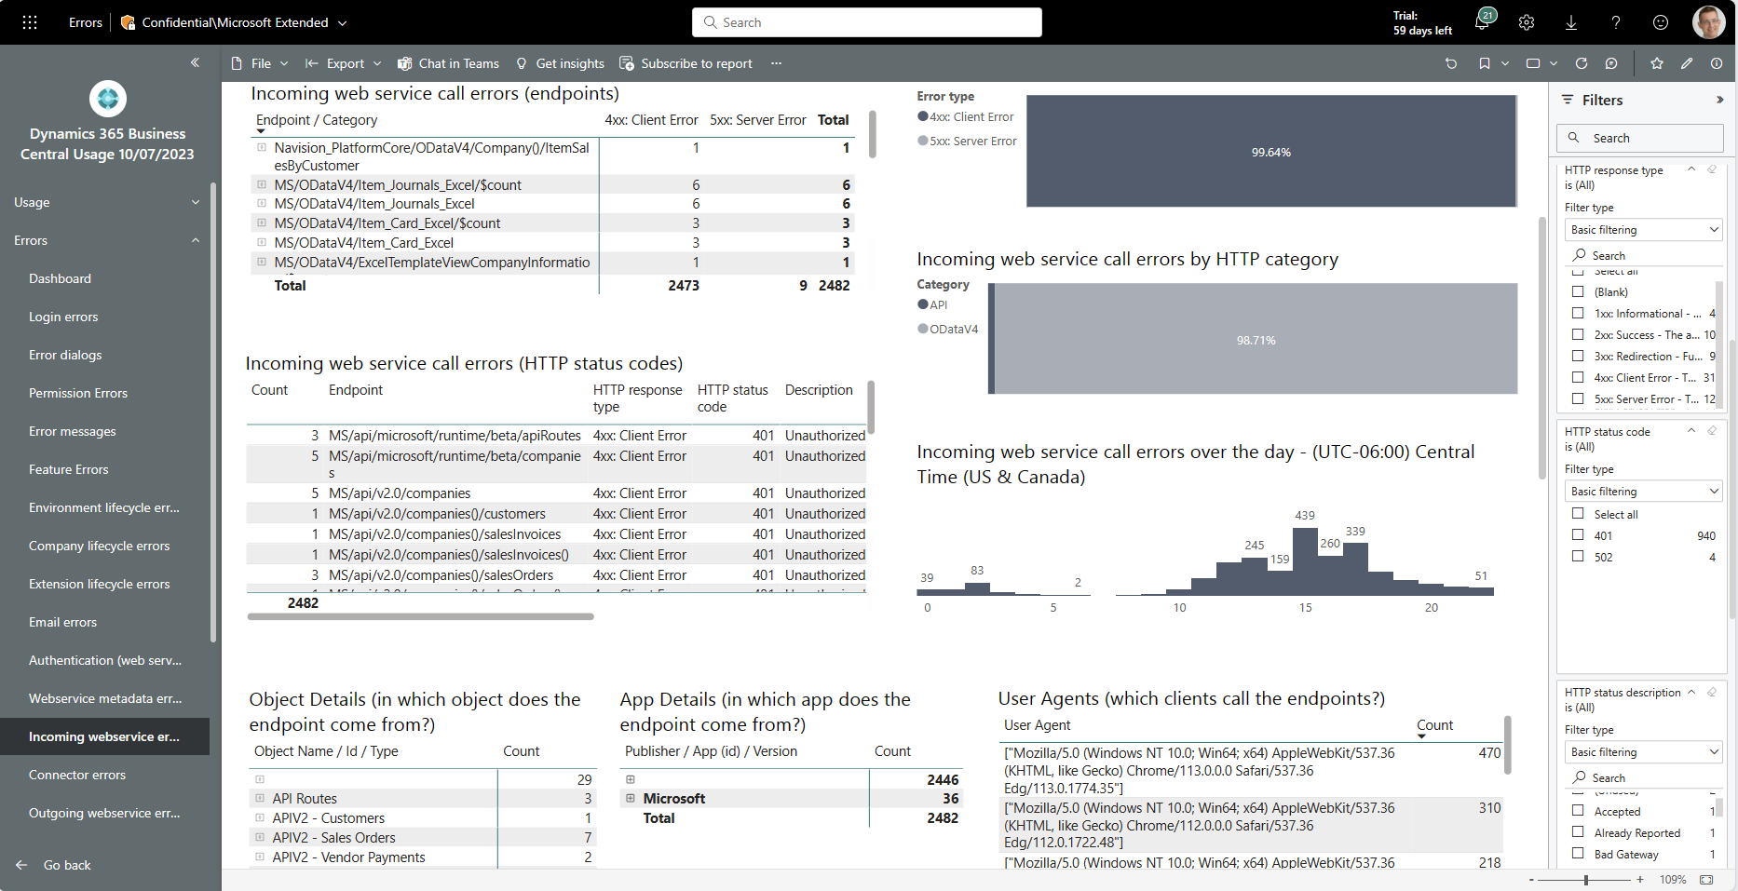
Easier troubleshooting of incoming web service errors
Improved filters on HTTP status codes
Two new visuals that show HTTP status code view on errors

Slide 17
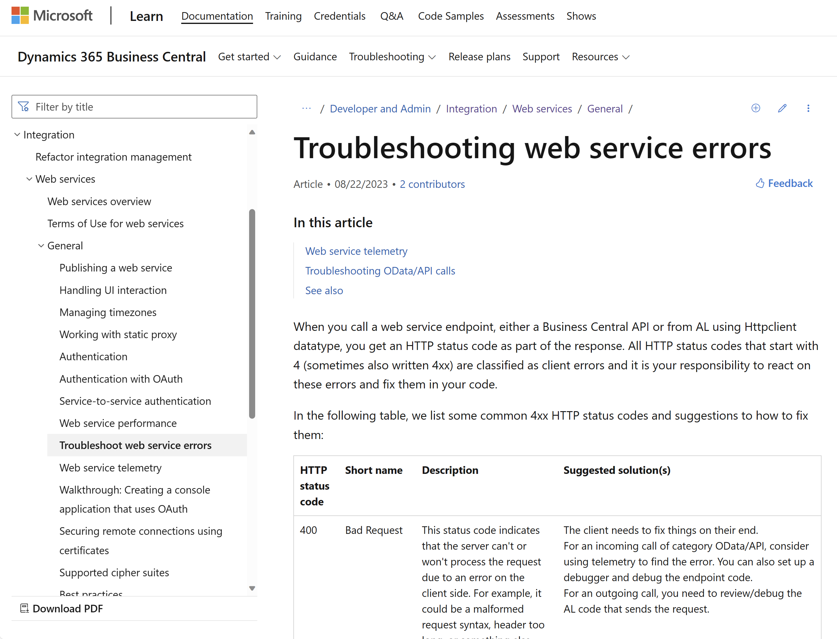
New TSG in docs

Slide 18
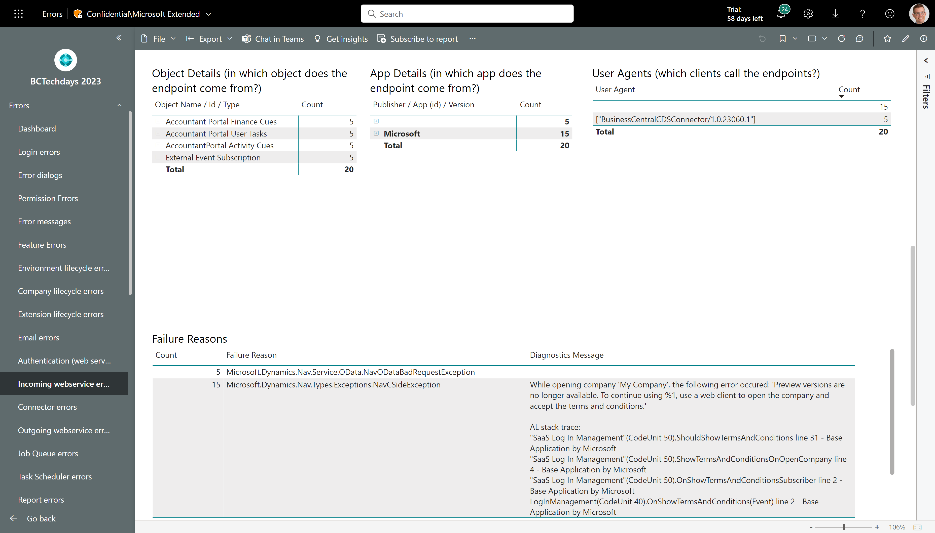
Troubleshoot web service calls – user agents and exceptions
Which web service client experienced issues?
Which exception was thrown by the server, what was the AL error and AL stack trace (if available)?

Slide 19
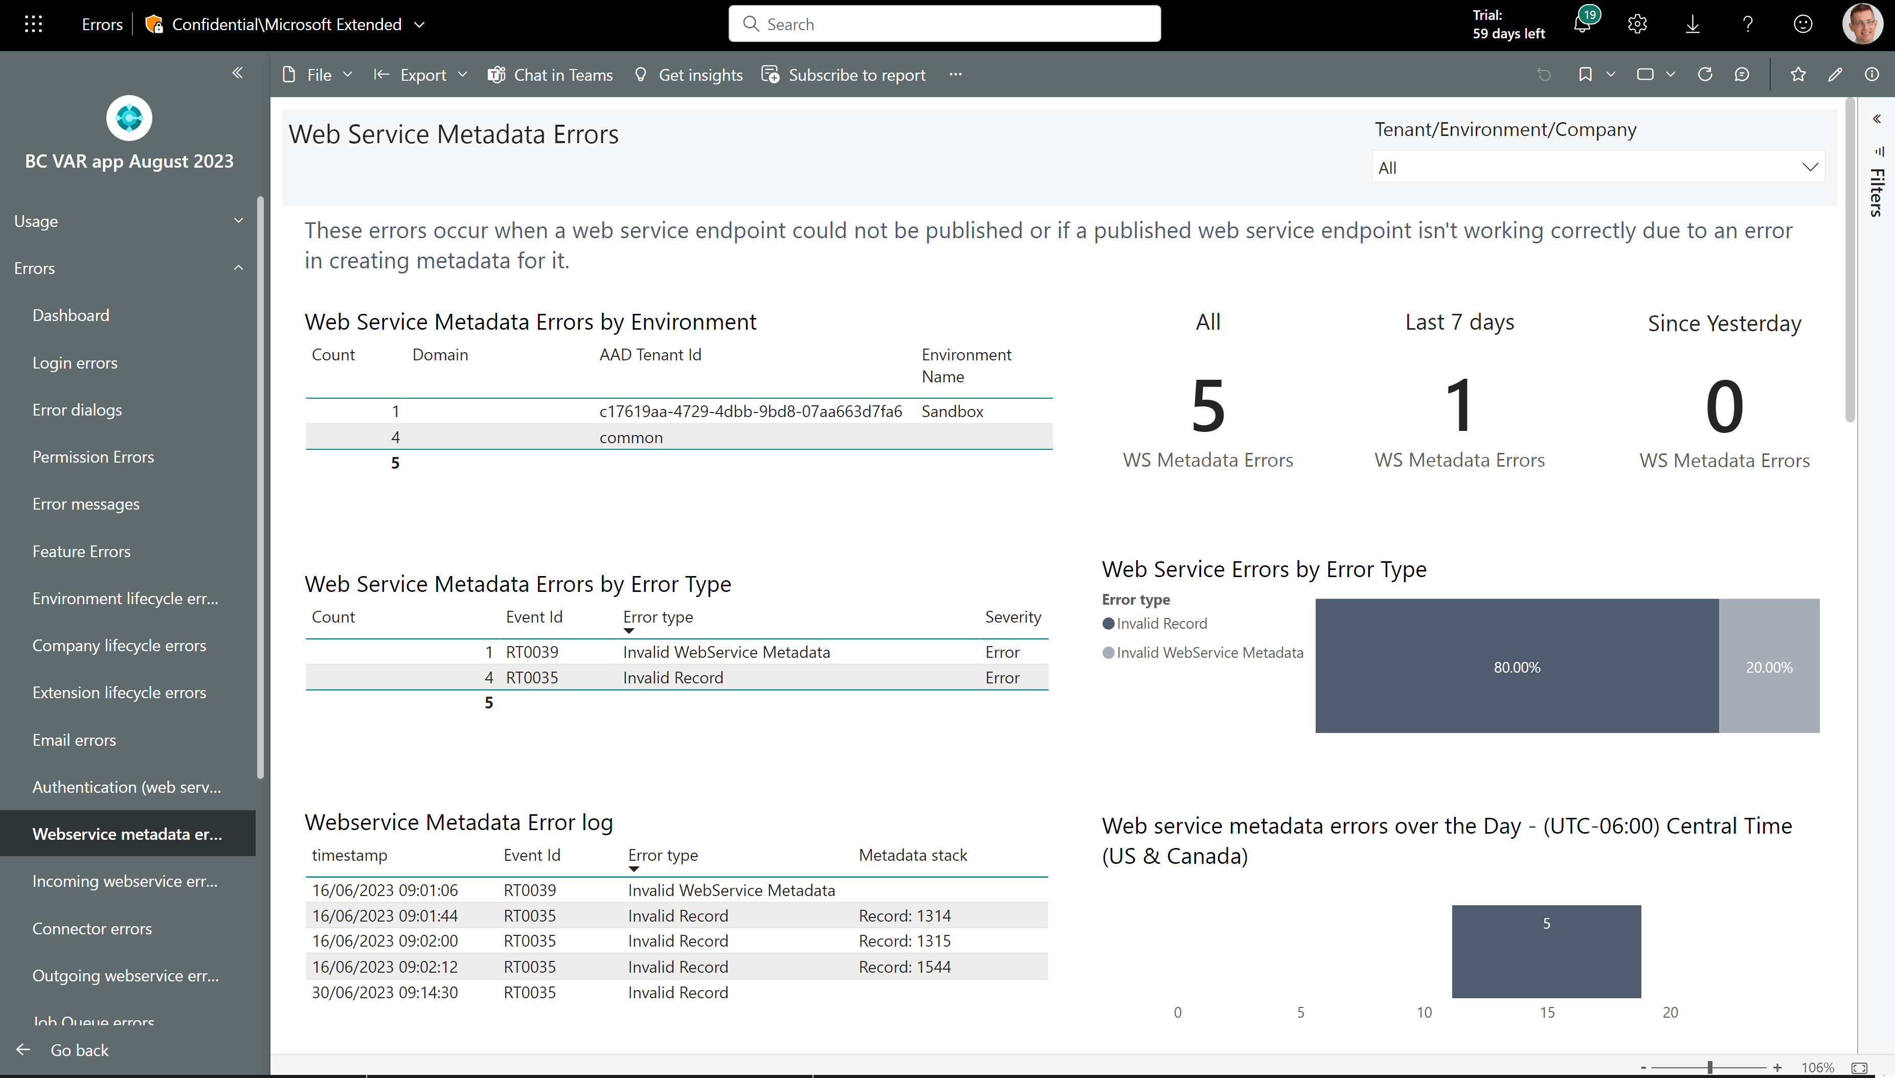
New page: Web service metadata errors
Find web service endpoints that fail at runtime and how to fix them

Slide 20
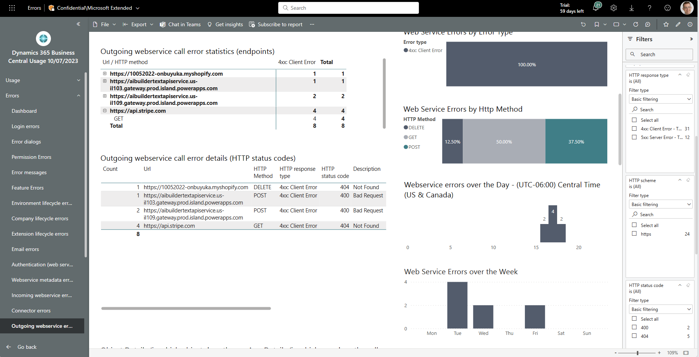
Easier troubleshooting of outgoing web service errors
Improved filters on HTTP status codes
Two new visuals that show HTTP status code view on errors

Slide 21
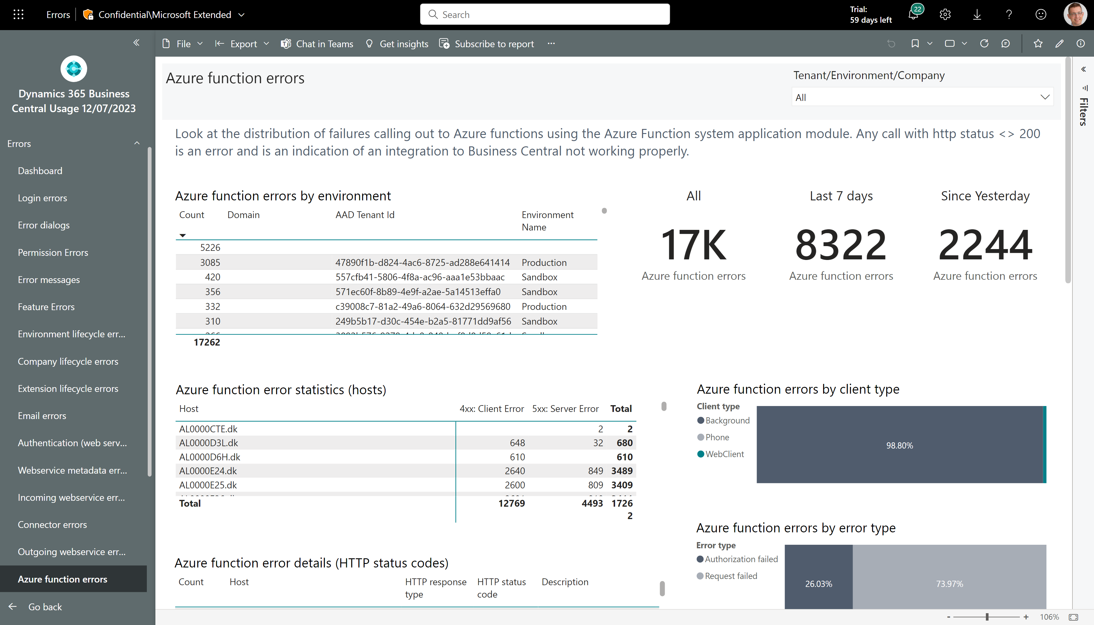
New page: Azure function errors
Find errors happening in integrations to Azure functions

Slide 22
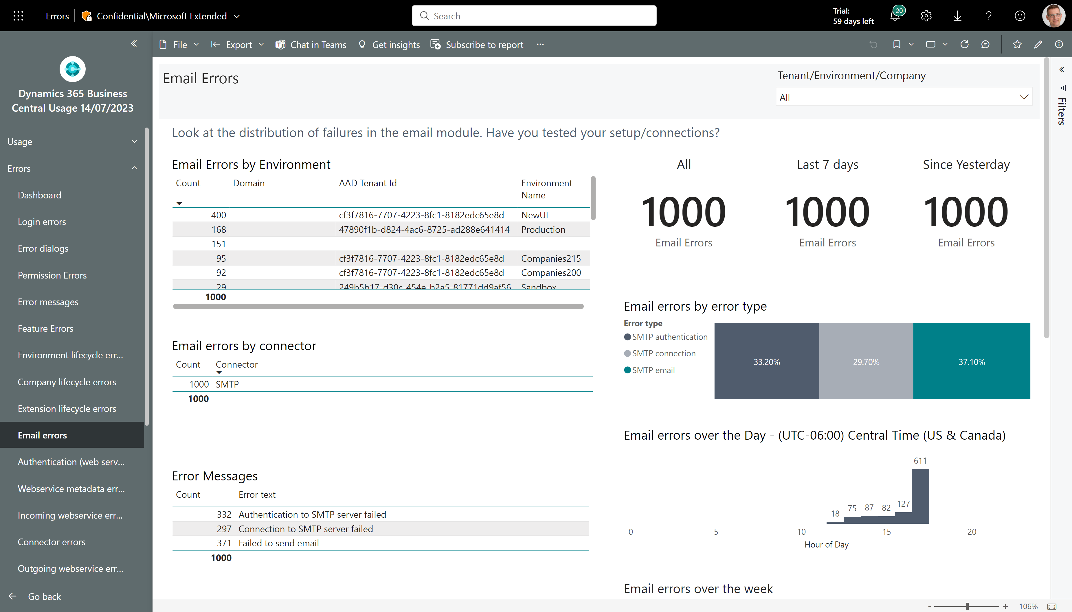
Easier troubleshooting of email errors (using new SMTP error signal from 22.3)
Three new SMTP email error events added in 22.3. Showing them here.

Slide 23
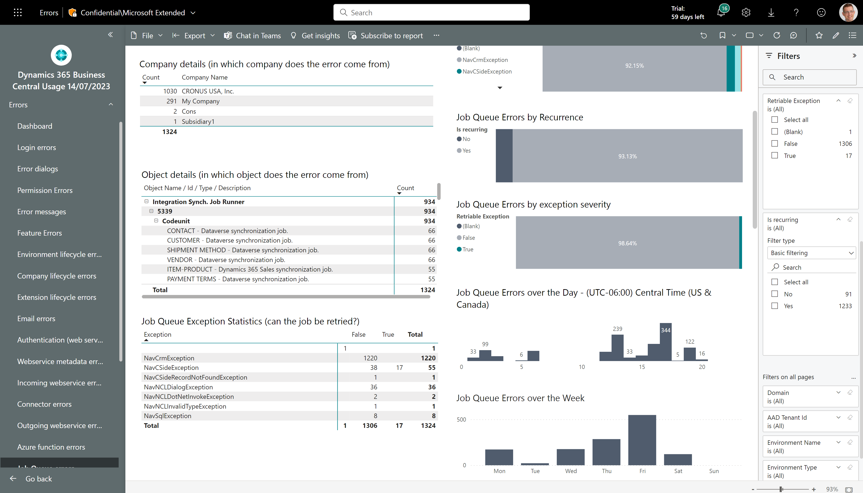
Easier troubleshooting of job queue errors
New visuals showing non-retriable job queue exceptions and recurring failing job queue entries
Improved filters to find problematic job queue entries
New visual showing non-retriable job queue exceptions

Slide 24
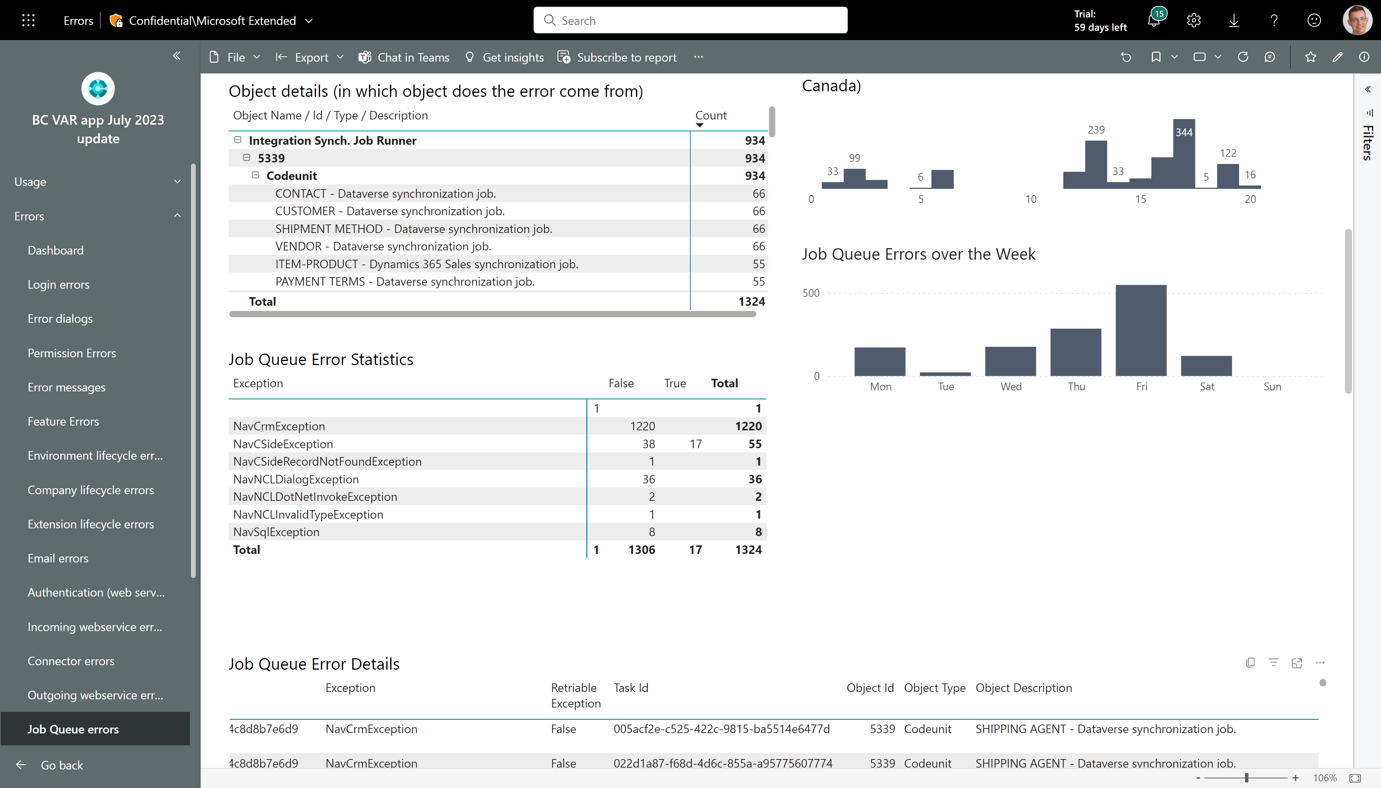
Job Queue Errors – see Job Queue description
Job Queue Descriptions are now emitted to telemetry

Slide 25
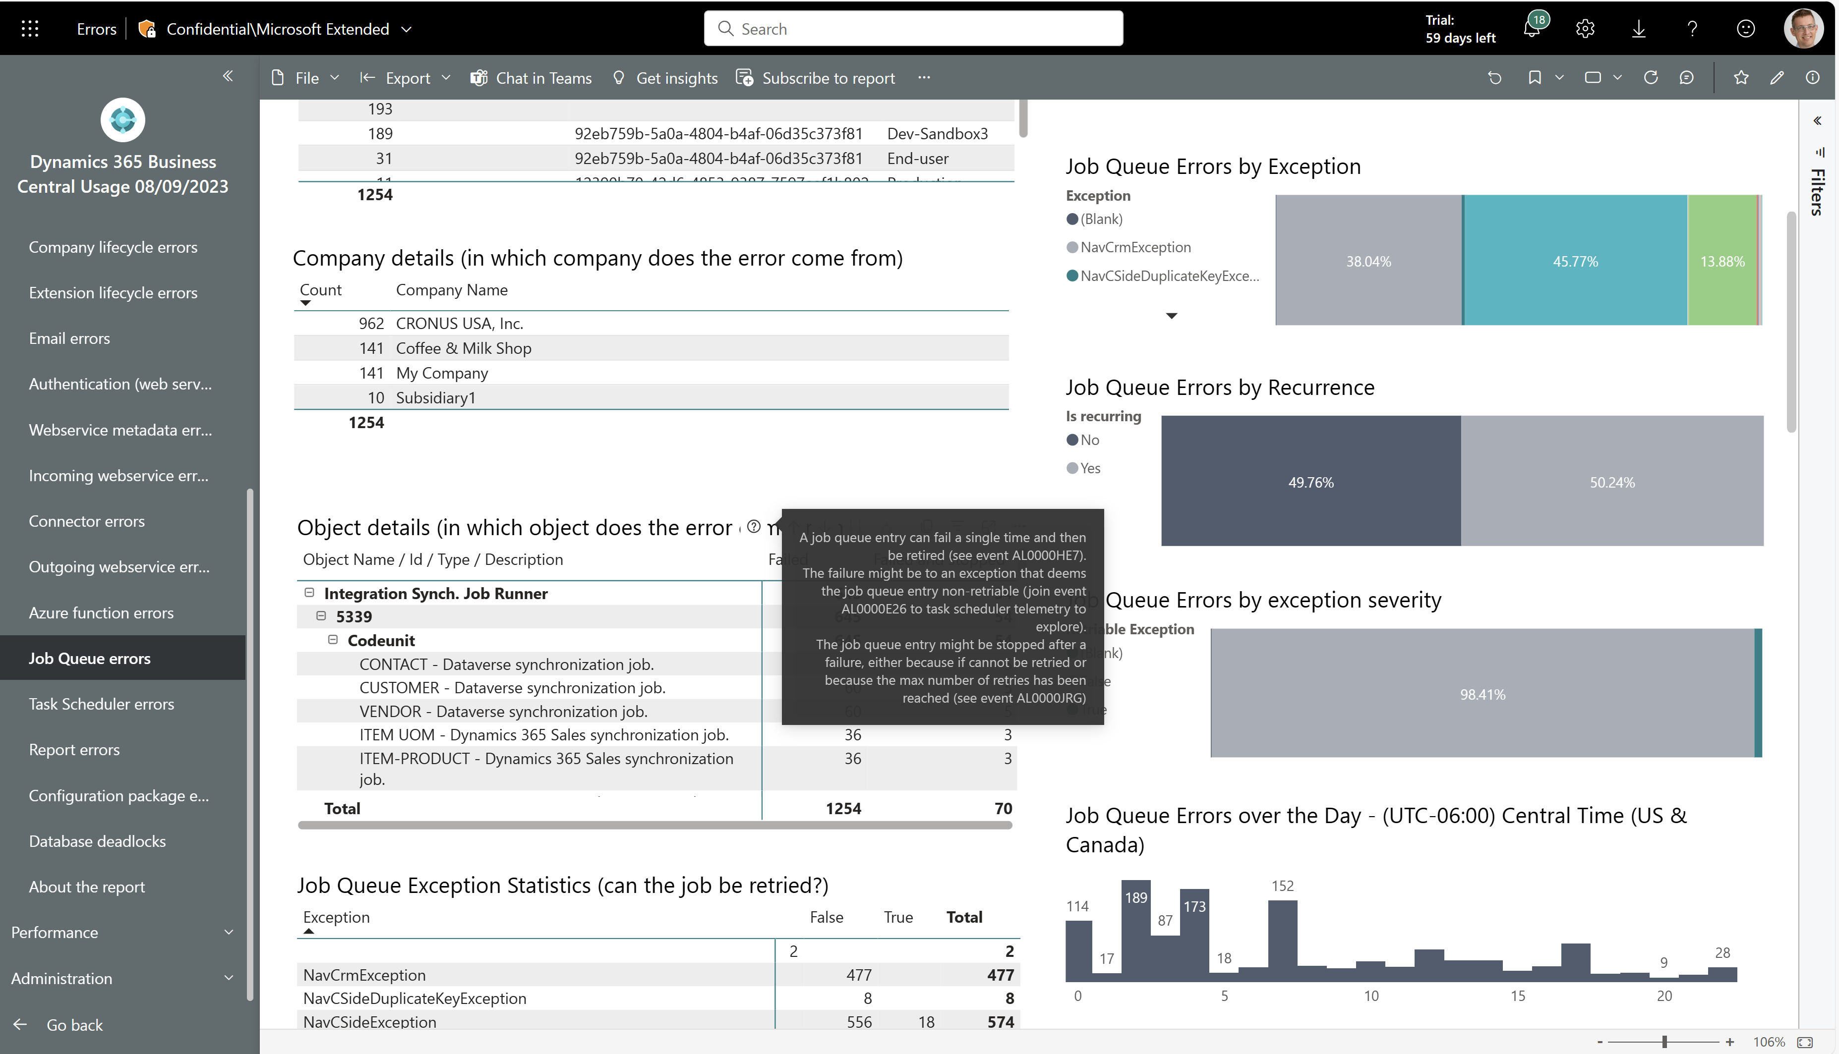
Job queue errors: Now shows job queue entries that are stopped by the platfom
Find job queue entries that repeatably fail and are then stopped by the platform

Slide 26
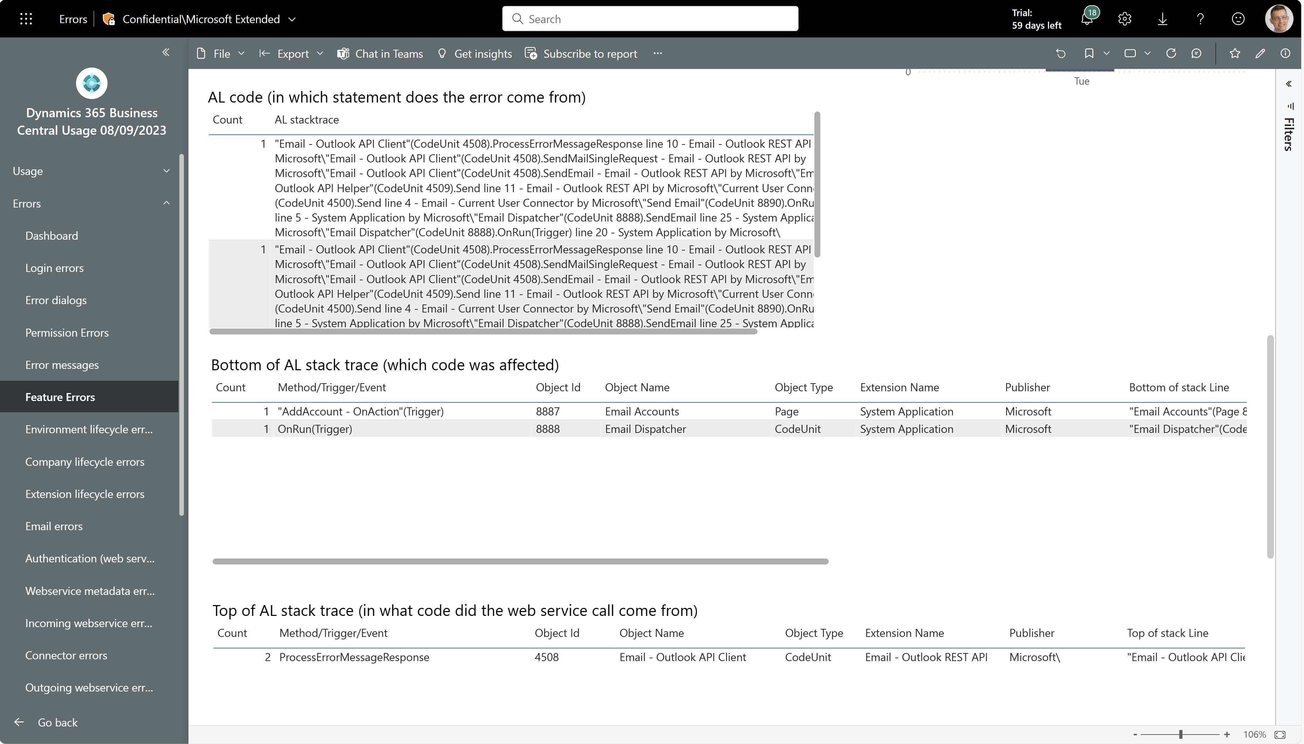
Easier troubleshooting of feature errors
Feature errors now also show top/bottom of AL stacktrace

Slide 27
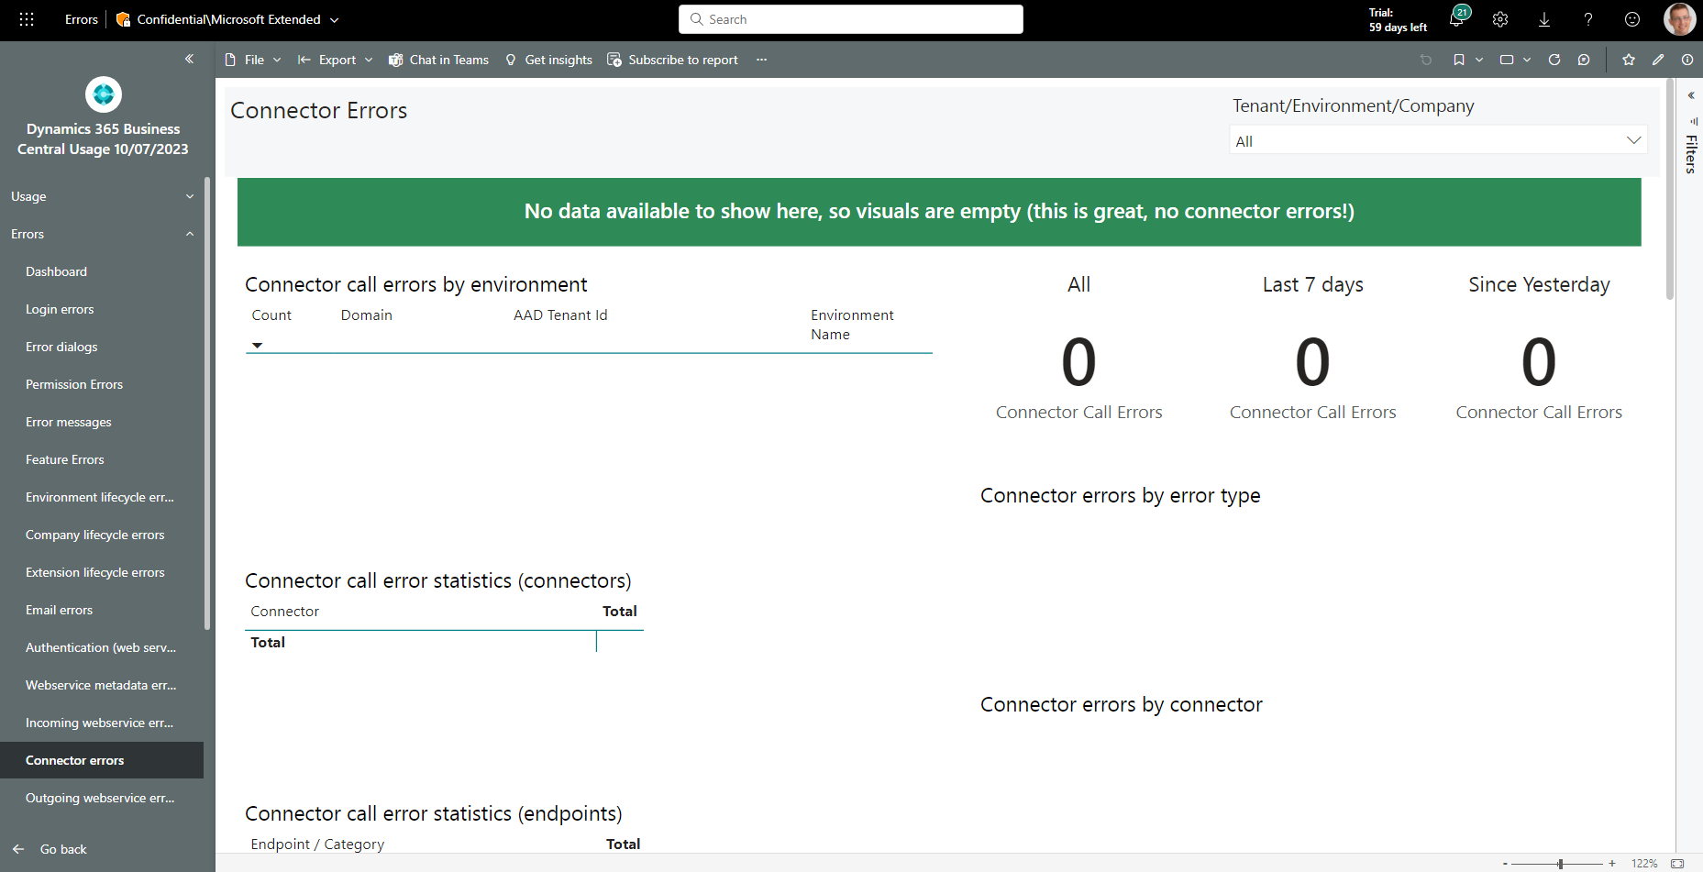
On all error pages: green banner shown if no data
If no data is present on an error page, we now show a green banner

Slide 28
Coming soon (23.0 and later)

Slide 29
Changelog lifecycle events (23.0/23.1)
Get an event whenever a table/field is added/removed from the changelog configuration.
Allows you to setup alerts on the situation that an administrator by mistake cause a performance problem by setting up changelog non-optimally.

Slide 30
PTE upload validations (23.0/23.1)
Get an event whenever a PTE is uploaded in the client.
Allows you to setup alerts on the situation that someone is installing PTEs on an environment.

Slide 31
PTE validations against next major (23.0/23.1)
Get an event whenever a PTE is validated (compiled) on the next major of Business Central.
Allows you to setup alerts on the situation that the environment is blocked for update due to incompatible PTEs.

Slide 32
Business Events (23.0/23.1)
Get events for the new Business Event feature in Business Central.

Slide 33
Tips and tricks

Slide 34
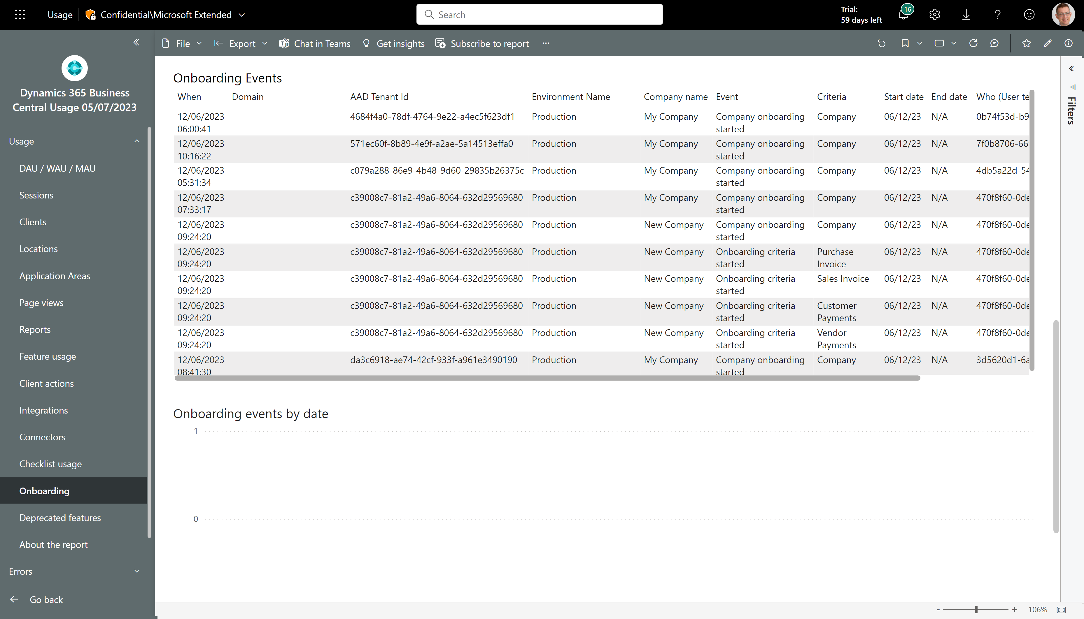
New page: Onboarding
See how environments start and finish onboarding criteria

Slide 35
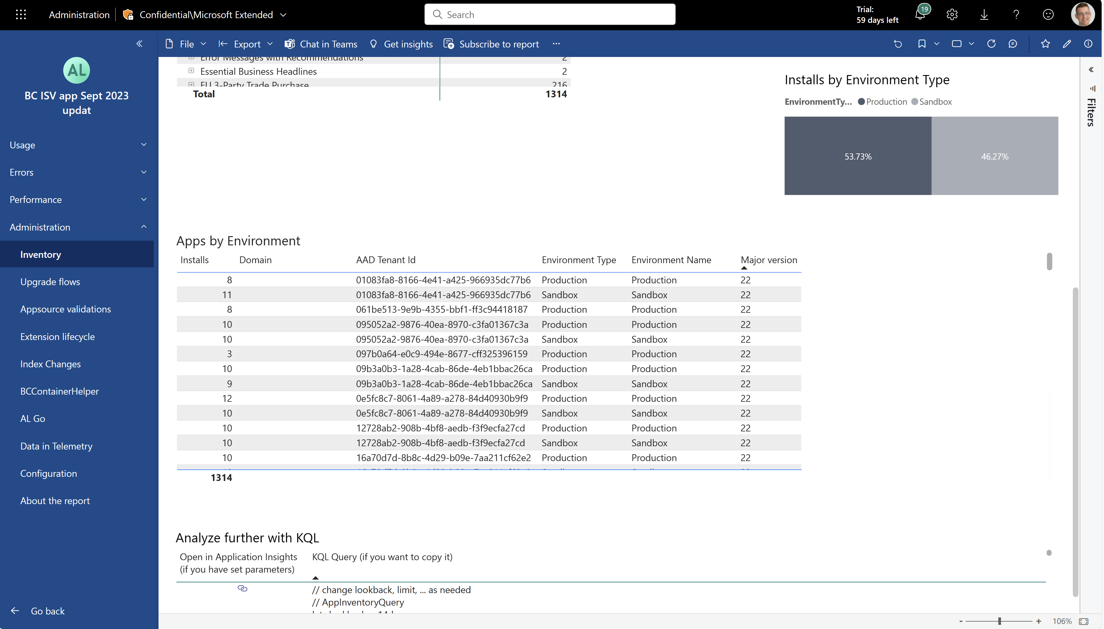
ISVs can see the major version of Business Central for their install base
Inventory report now shows major BC version for environments where your app(s) are installed

Slide 36
Resources (I want it and I want it now)

Slide 37
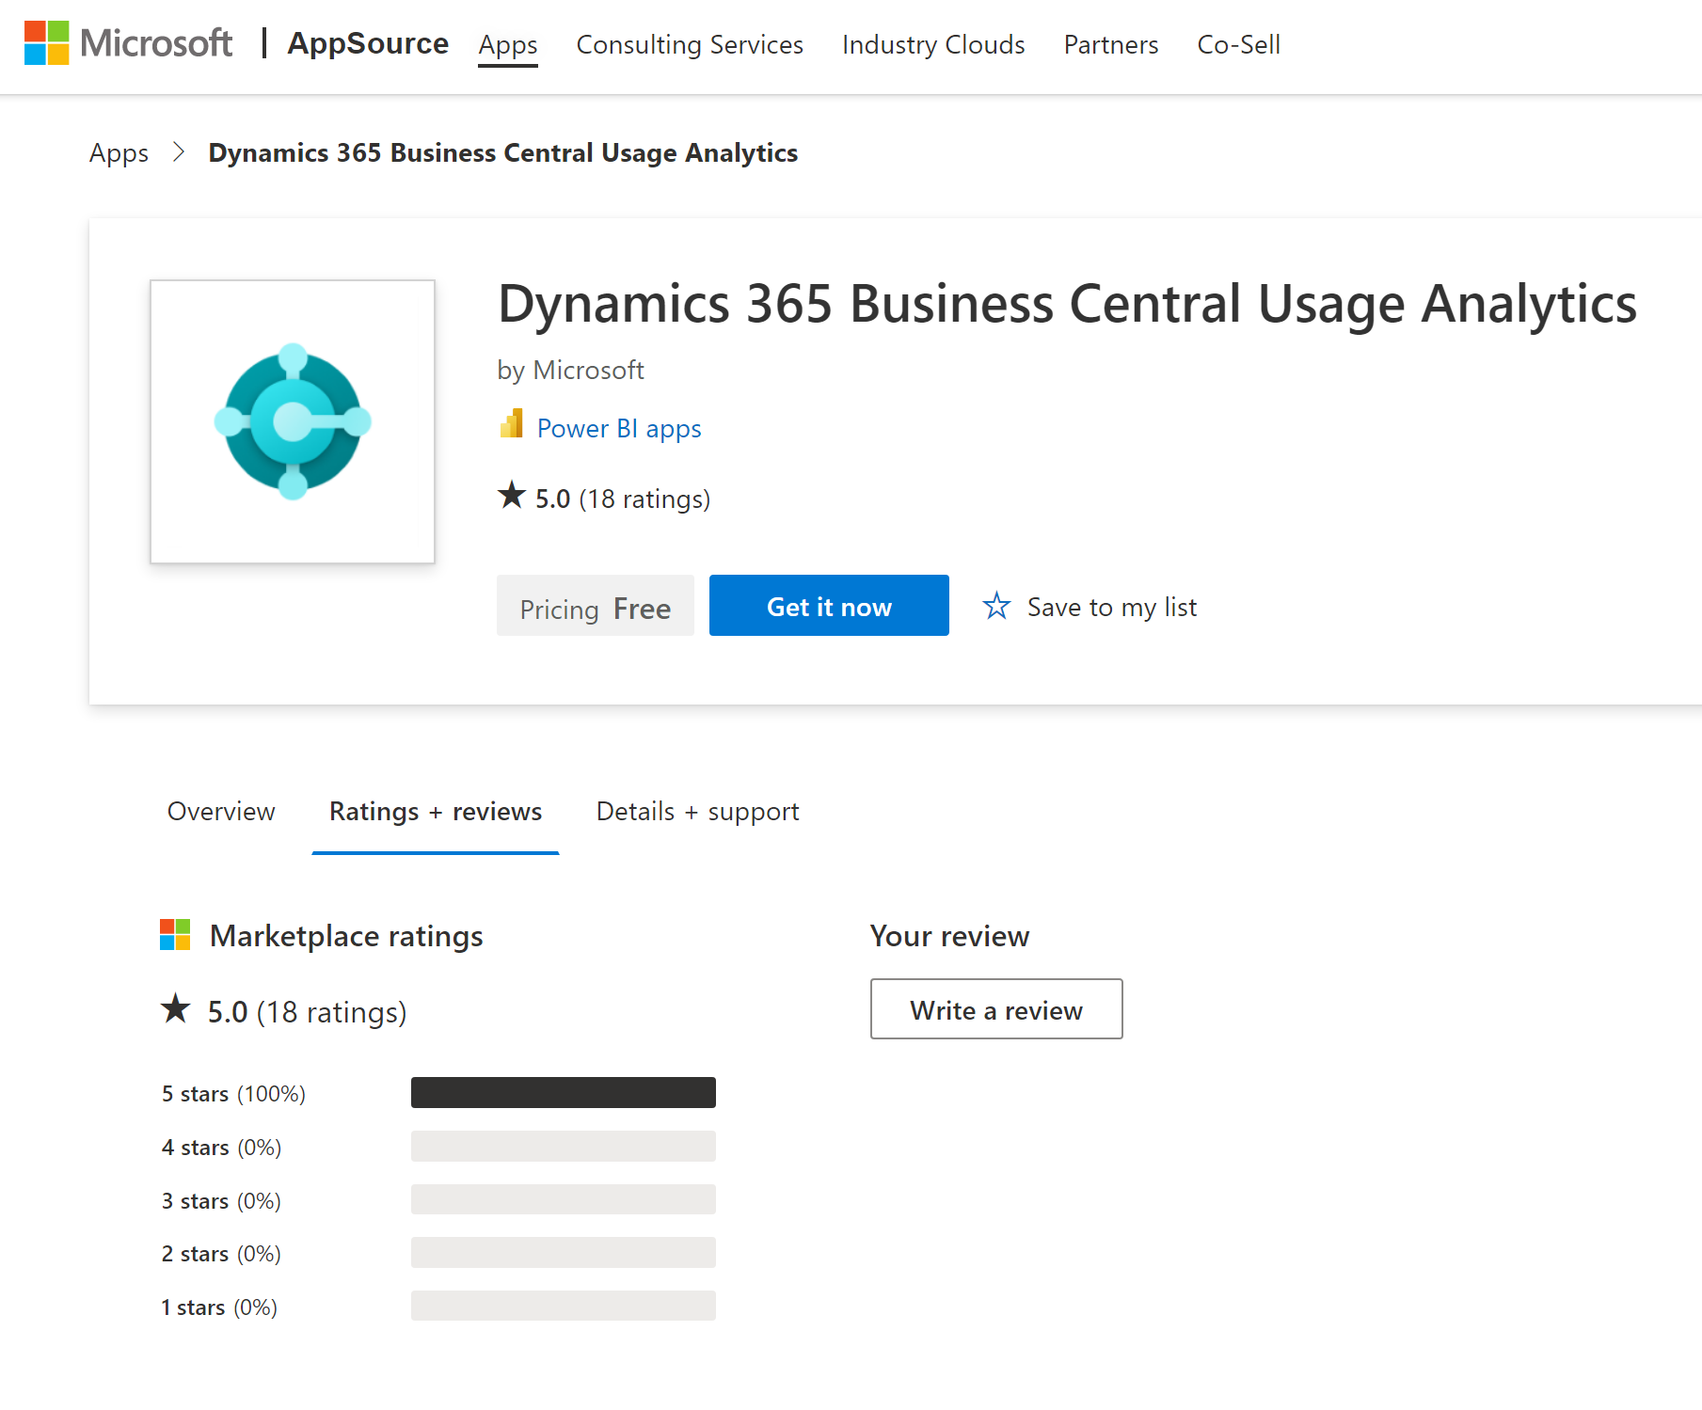
Install/update from Appsource (available now)

Slide 38
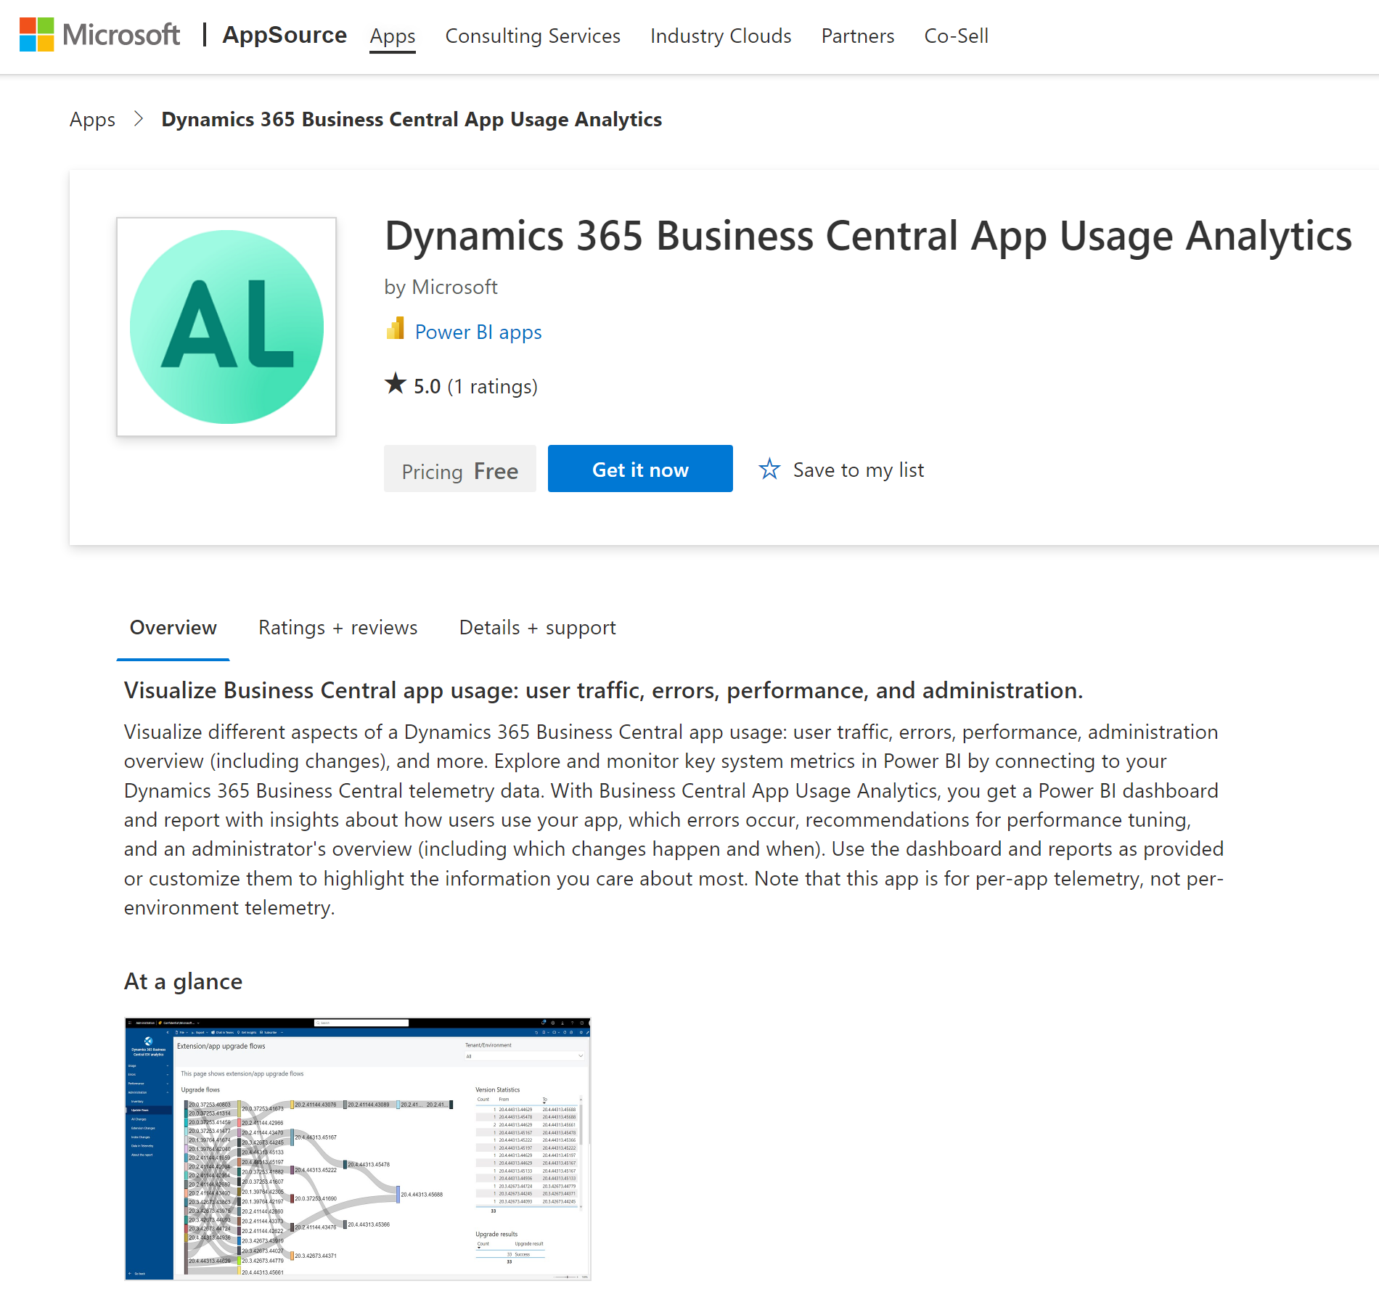
Install/update from Appsource (available now)

Slide 39
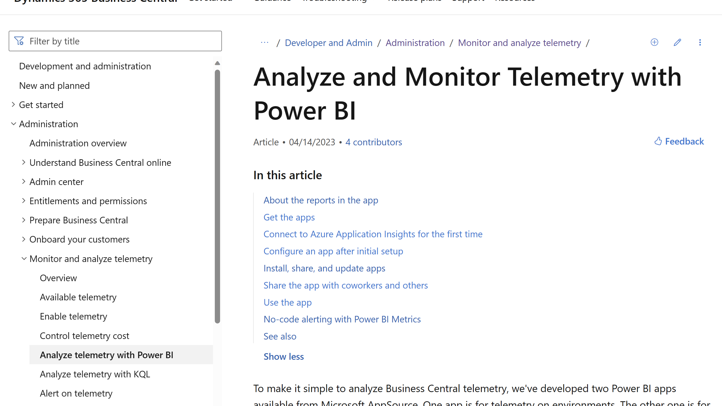
aka.ms/bctelemetry

Slide 40
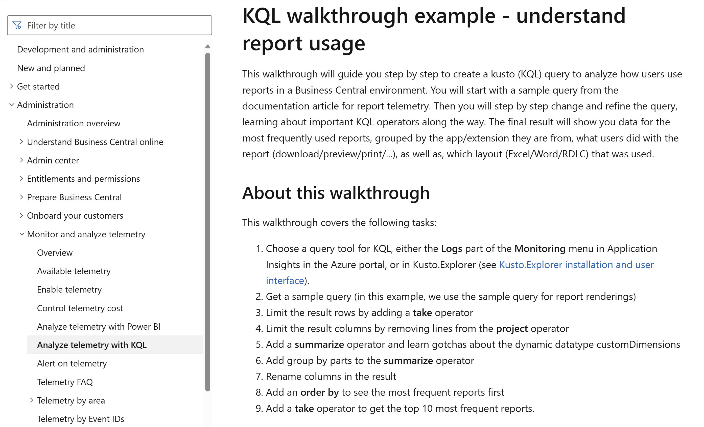
aka.ms/bctelemetry
New

Slide 41
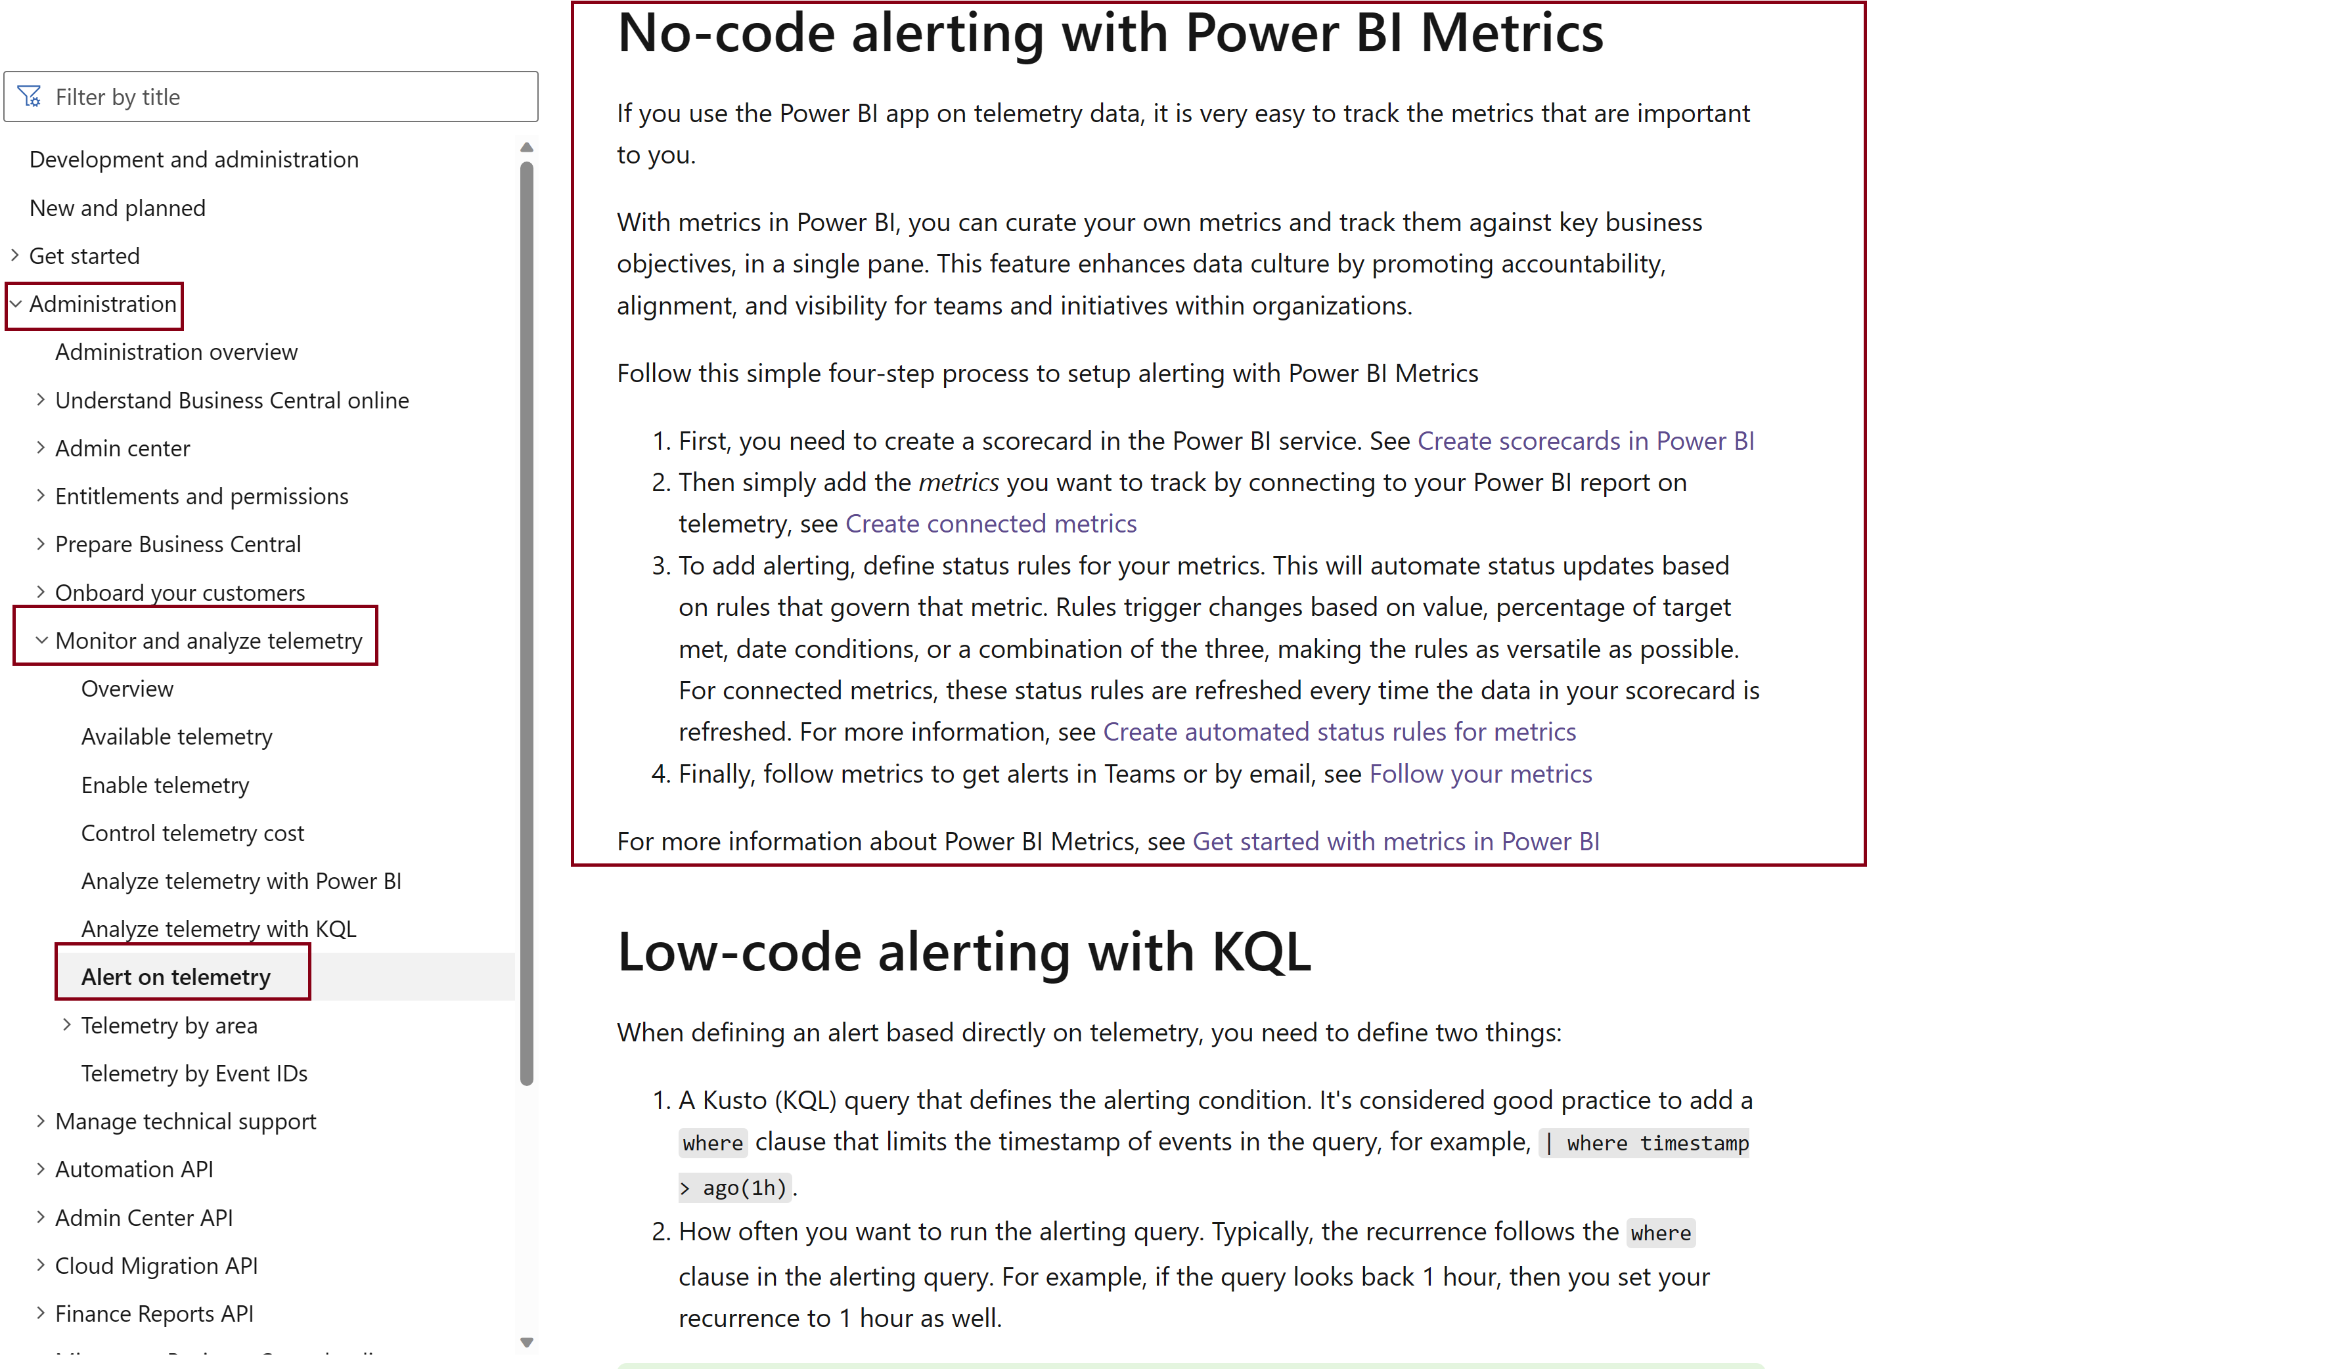

Slide 42
Go dos
Enable telemetry
Install Power BI apps
Setup alerts
Get data-driven
Deploy an Azure Application Insights resource.
Add to environment (also works for on-premises)
Requires Power BI pro license.
Give you easy insights into usage, errors, performance, and changes to the environment.
Use no-code approach with Power BI metrics.
or
Use low-code approach with LogicApps or Power Automate flows.
Use data to take decisions in every part of your partner practice:
Pre-sales
Go-live
Operations
Support
Ongoing sales

Slide 43


Watch other relevant launch event sessions
What's new: Creating customer centric onboarding experiences
Performance testing before go-live with Performance Toolkit

Slide 44





General Business Central resources, learn more!
Join the conversation twitter.com/ MSDyn365BC
Submit your ideas aka.ms/BCIdeas
Have a question?
aka.ms/BCYammer
Looking for resources?
aka.ms/BCAll
Join the office hours
aka.ms/BCOfficeHours

Slide 45

Thank you

